Slide 1
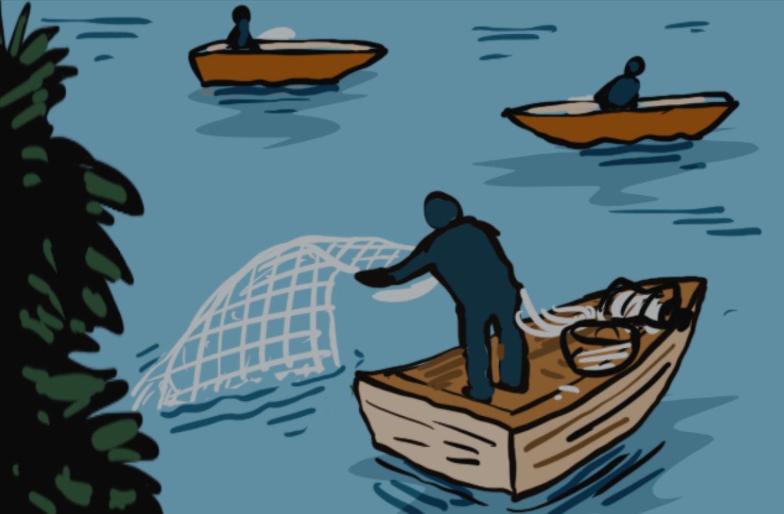
Training on the Practical Measures for Armed Actors to Prevent and Mitigate Conflict-Induced Food Insecurity
Module 7
Bringing It Together: Reflections and Closing​
Notes:
Notes:
Module 7, Bringing It Together: Reflections and Closing
Note: This module would need to be adapted according to the specific situation and priorities that you and the participants would like/need to work on. ​
For armed actors, you can prepare it based on your previous knowledge and inputs from people knowledgeable about the organization/situation, but you should reassess the focus after the first day’s training. ​
Use the questions and exercises that correspond to your needs, not all or them. We would recommend to use at least the recaps/going back to previous exercises they did, the reflection exercise (in plenary), and then choose one-two exercises out of the six available. ​
Exercises marked with the icon of the soldier are adequate for armed actors (15, 16.A, B, C, and D).​
Exercises marked with the icon of the four men and women are adequate for civil society (15, 16.A, B, E, and F).​
Exercises that are good for both groups of participants are marked with both symbols (15, 16.A and B)
Time needed: 90 minutes​
(+30 minutes for the Closing Session)​
Set-up: free set up, space for group work​
Material: flip chart or similar available for note-taking, big sheets of paper and markers for group exercises, post-tests (Annex 3.A) and feedback forms for participants (Annex 3.C), certificates if you provide them​.
​

Slide 2

Learning objective module 7
Participants are aware of the challenges and opportunities for preventing and mitigating food insecurity in their context and are able to identify possible strategies and next steps.
02
Notes:
Notes:
Learning objective: ​
Explain that the objective of this module is that participants are aware of the challenges and opportunities for preventing and mitigating food insecurity in their context, and are able to identify possible strategies and next steps. ​
Explain that this module is there for them to bring together all what has been discussed and make sense of it in their own context. ​
Say that in order to do so you will recap some of the main issues that were discussed and provide them with a framework to analyze and strategize what can be done.​

Slide 3

Recap
  Conflict-induced food insecurity is largely preventable​
  Armed actors have a responsibility to prevent and mitigate conduct that would result in food insecurity​
  Practical measures = a guidance tool for armed actors + an advocacy tool for humanitarian, civil society and diplomatic actors
03
Notes:
Notes:
Recap that conflict-induced food insecurity is largely due to how armed actors behave and that they have a responsibility to prevent and mitigate civilian harm.​
Recap that the “Practical Measures” tool aims to help armed actors – and the humanitarian, civil society and diplomatic communities that engage with them – to address conflict-induced hunger. ​
- For armed actors it is a guidance tool to help them better prevent and mitigate conduct that would result in conflict-induced food insecurity.​
- For humanitarian, civil society and diplomatic actors it is an advocacy tool to engage in more targeted outreach and negotiation with armed actors.​
​

Slide 4
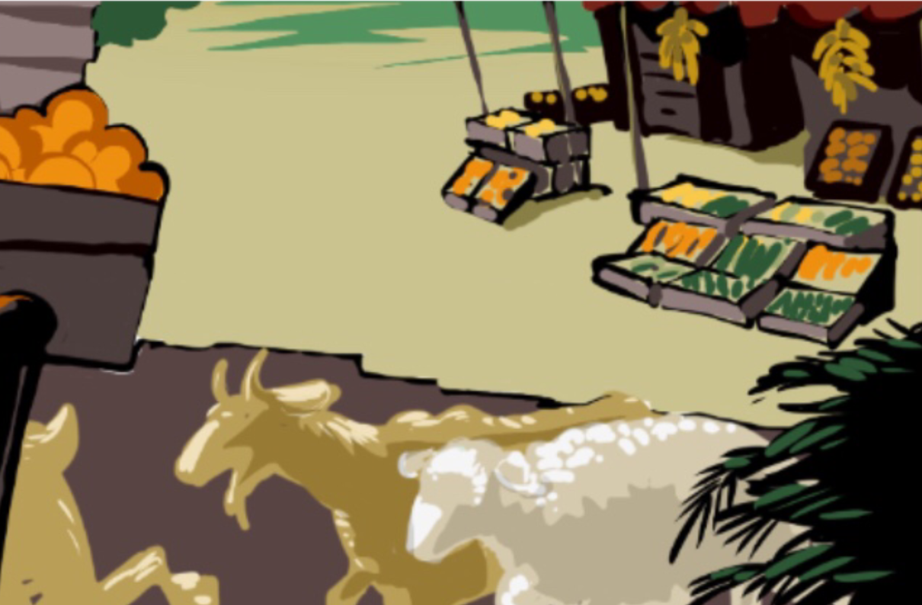
Recap on possible next steps
04
Notes:
Notes:
Remind them that, for the next steps:​
Armed actors whether operating in situations of armed violence or conflict can choose to:​
- Directly incorporate measures into policy & practice​
- Apply the measures through security partnership assistance​
Humanitarian actors and civil society more broadly speaking, as well as communities, can push for the uptake of these measures in part or as a whole amongst armed actors. They can also assist in such efforts by armed actors.​
This training material, as well as the awareness-raising material that has been developed can be tools in that process. ​
But it is likely that the measures will need to be contextualized and reframed according to each context. ​
​

Slide 5





  Do the Practical Measures respond to the concerns in your context? If implemented, could they help prevent and mitigate conflict-induced food insecurity in your context? Why/why not?​
  Is there a measure that could be added?
​
  What would be your priorities in terms of implementation?
Reflection
06
Notes:
Notes:
Exercise 15: Refection on the Practical Measures: to be done in plenary
Note: This reflection can be used for armed actors and civil society​
Explain that now that they have much more knowledge of what the Practical Measures are, you can discuss how they can be implemented.
Ask them:​
- Do the Practical Measures respond to the concerns in your context? If implemented, could they help prevent and mitigate conflict-induced food insecurity in your context? Why/why not?​
- Is there a measure that could be added?​
- What would be your priorities in terms of implementation? ​
​​
​

Slide 6

Re-assessing the potential of the Practical Measures
Policies and practices for Civilian Harm Mitigation​
Considerations for planning and conducting military operations
Partners and allies
Addressing harm caused
05
Notes:
Notes:
Exercise 16.A: Group exercise of choice on operationalizing the Practical Measures.
For armed actors you might have done this exercise in the Practical Measures module 2 and depending on the outcomes you might want to choose to build on what was done.
For civil society actors you may not have done, it, hence you can develop it here, as described in Exercise 4: Exploring the potential of the Practical Measures.​
Remind they that in module 2 they discussed some potential uses of the Practical Measures tool in their context. ​
If they have notes from this (one sheets of paper), bring them up.​
Leave the slide with the key areas on for a moment, as this can remind them of the concrete issues that you already discussed throughout the training.​
​
​

Slide 7

Exercise: Operationalizing the Practical Measures
  What are the priorities to address in terms of improving civilian’s food security? What would be the role of different actors in addressing these issues (armed actors, communities, humanitarian actors, others…)? What would be the incentives for uptake/implementation? ​
  What policies and procedures should be put in place for this purpose? ​
  Who should do what to operationalize the Practical Measures?​
  What would be the main (internal and external) challenges? What would be the main opportunities? What strategies could be put in place to maximize those opportunities and mitigate the challenges?
07
Notes:
Notes:
Exercise 16.B: Group exercise of choice on operationalizing the Practical Measures
(in groups) (60 minutes).
Can be used for all actors, including civil society.
​
Ask the participants to split into smaller groups (3-5 people). ​
Read the questions with them and make sure they understand well.
Give them about 30 minutes to discuss and prepare some bullet points. They can decide which questions they want to prioritize.
1-2 persons from each group gives a recap of the discussion.​
Go through their answers with them, take about 20-25 minutes for the discussion and feedback. ​
Make sure to give plenty of space to the discussion points on incentives and ask them what could be the benefits for the different actors, including the armed actors themselves, if the Practical Measures were to be implemented.
​

Slide 8

Improving food security in operations
  Strengths and weaknesses: What are the strengths and weaknesses of your policies and practices in relation to food security?​
  Policies and practices: How could policies and practices be changed or better implemented to improve food security?​
  Incentives: What could be the benefits to you if you take measures to improve food security?
  Objectives: What would be a concrete objective that could be reached? How would it look like (ex. improved assess of farmers to their field at all relevant times)​
  Process: What should come first for that to happen? ​Who would need to do what for that to happen?
09
Notes:
Notes:
Exercise 16.C: Group exercise of choice on operationalizing the Practical Measures.
This exercise is focused on how to improve food security and considers both policy and practice. ​
The exercise is better done in smaller groups, so ask them to split into smaller groups (3-5 people). ​
Read the questions with them and make sure they understand well. Tell them that they can choose to focus on some of the questions.
Give them about 30 minutes to discuss and prepare some bullet points.
1-2 persons from each group gives a recap of the discussion.​
Go through their answers with them, take about 20-25 minutes for the discussion and feedback. ​
The questions are:​
What are the strengths and weaknesses of your policies and practices in relation to food security?​
How could the polices and practices be changed or better implemented to improve food security?​
What could be the benefits to you if you take measures to improve food security?
What would be a concrete objective that could be reached? How would it look like (ex. improved assess of farmers to their field at all relevant times)​
What should come first for that to happen? ​Who would need to do what for that to happen?​

Slide 9

Exercise: Improving food security through civilian-harm mitigation policies
  In which ways could your existing policies be improved to further protect civilians and their food security?​
  Would a specific policy be needed, or should it be integrated into existing policy? ​
  What would be the actions required for this to happened and who would need to be involved in the process?
08
Notes:
Notes:
Exercise 16.D: Group exercise of choice on operationalizing the Practical Measures.
This exercise is focused on policies for civilian-harm mitigation.​
Whether the participants discussed their own policies in exercise 5 of the civilian harm mitigation session or not, return to the notes on the ways in which they thought the studied policies could be improved related to food security.​
You can choose to do this exercise either in plenary or in smaller groups.
Depending on what was discussed in module 3, this exercise can be longer or shorter. If they are particularly motivated they can start drafting some ideas for an improved or new policy.
​
Look at the key issues that came up for improvement​
Ask them: now that the training is over, which are the most important new or improved specific mitigation policies that your organization would consider adopting relating to food security?​ In other words, In which ways could their existing policies be improved to further protect civilians and their food security?
Would a specific policy be needed, or should it be integrated into existing policy? ​
What would be the actions required for this to happen and who would need to be involved in the process?

Slide 10
  How does trainings work within the organization?​
  What types of trainings specifically on preventing and mitigating food insecurity would be needed:​
    on what ​
    for whom ​
  What could be the role of civil society in supporting such training processes?
Identifying training needs of ​
armed actors​
10
Notes:
Notes:
Exercise 16.E: Exercise of choice on operationalizing the Practical Measures
Exercise Identifying training needs: (30 minutes, 15 in small groups and 15 in plenary)​
Note: For armed actors this exercise was done in module 6. ​
​Ask them ​if they can explain how training is done within the target organization(s) (at what point in the recruitment, how often, for whom, on what topics)​
Ask them what different types of trainings would be needed to improve the implementation of policies on food security?
Ask them who would need to receive which trainings. For example:​
On existing or new policy: all staff?​
On anticipating how military operations and behavior of personnel might impact civilians: planning staff? ​
Ask them what detailed content would need to be included if they had to design a training to collect, track, and analyze the necessary information on civilian harm​. For example on:​
The interconnectedness of critical infrastructure and essential services in urban environments and how conflict, specifically the use of explosive weapons, impacts civilian harm and food security in this environment.​
The causes of displacement and migration and the effect of these on various populations, including displaced and host communities. Particular attention could be placed on understanding the protection risks these communities may face and which segments of the population are most vulnerable to them.​
The humanitarian system, mechanisms, and components and how they work in coordination with armed actors and authorities to respond to humanitarian needs.​
Ask them what could be their role/the role of civil society and humanitarian actors in such training processes?
Background notes:​
Sources: ​
ICRC, International Humanitarian Law Database, Rule 142.​
ICRC (2021), Urban warfare: an age-old problem in need of new solutions; and ICRC (2023), How can fighters reduce civilian harm in urban warfare?​
ICRC (2022), Explosive weapons: Civilians in populated areas must be protected.​
​

Slide 11
  What are the existing frameworks that the actor has in place? ​
  Can you give an example of when the framework has been used?​
  How could the framework be improved?​
  What could be the role of civil society and humanitarian actors?
Frameworks for monitoring, learning and applying lessons learned
11
Notes:
Notes:
Exercise 16.F: Exercise of choice on operationalizing the Practical Measures
Exercise frameworks for monitoring, learning and applying lessons learned : (30 minutes, 15 in small groups and 15 in plenary)​
Note: For armed actors this exercise was done in module 6.​
Ask them:​
- how this is done within the target organization and what framework/tools/processes they have in place ​
- if they can give an example of one moment when the framework was used​
- if they have any ideas how this framework could be improved, and finally​
- what could be their/the role of civil society and humanitarian actors in setting up and implementing such a framework
​

Slide 12

Module wrap-up & conclusions
12
Notes:
​Notes:
Session overview at a glance: Closing session​
Post-test and feedback forms available in Annexes 3.A-C (15-20 minutes)​
Module wrap-up using the test as a starting point
Closing​
Certificates
It is recommended that you as a facilitator use the post-test in the following way:
Distribute it to the participants in the beginning of the closing session and give them time to reflect and fill it out. They can either fill out the feedback forms at the same time or at the very end,
Explain that they will not be individually assessed, but that the idea is to assess the learning of the group as a whole.
Instruct them to read carefully and that more than one answer may be correct.
After they completed the tests, collect them.
Go through the questions and answers in plenary, letting participants answer and justify their choices. Take the time to discuss the answers and some complexities they may contain. You can use the comments in Annex 3.B as a starting point.
This discussion will serve as a good recap of the material covered in the training. Once you have gone through the correct answers to the test, ask them to add additional key learnings and main points from the training.
Close the discussion and thank them for their participation
Distribute the certificates
Ask the responsible commander or someone else to officially close the session and the training.

Slide 13
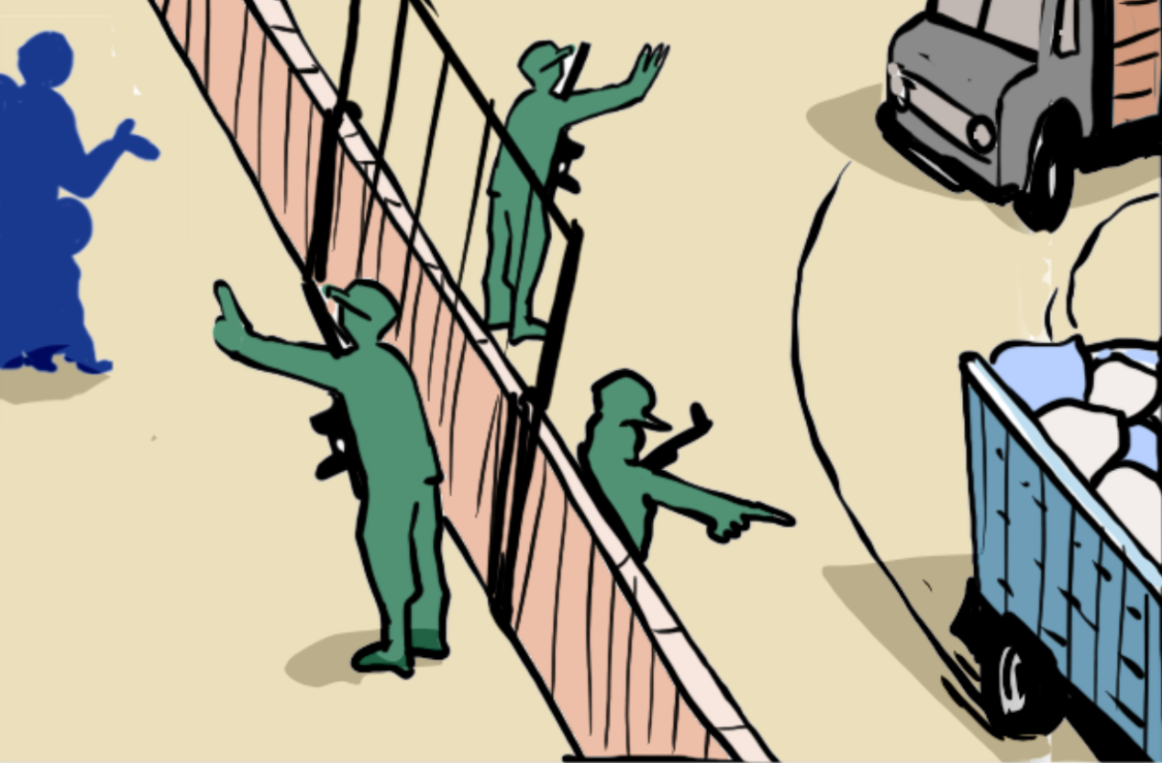
Questions?
Notes:
Notes:
Address any final questions or concerns raised by the participants.

