Slide 1
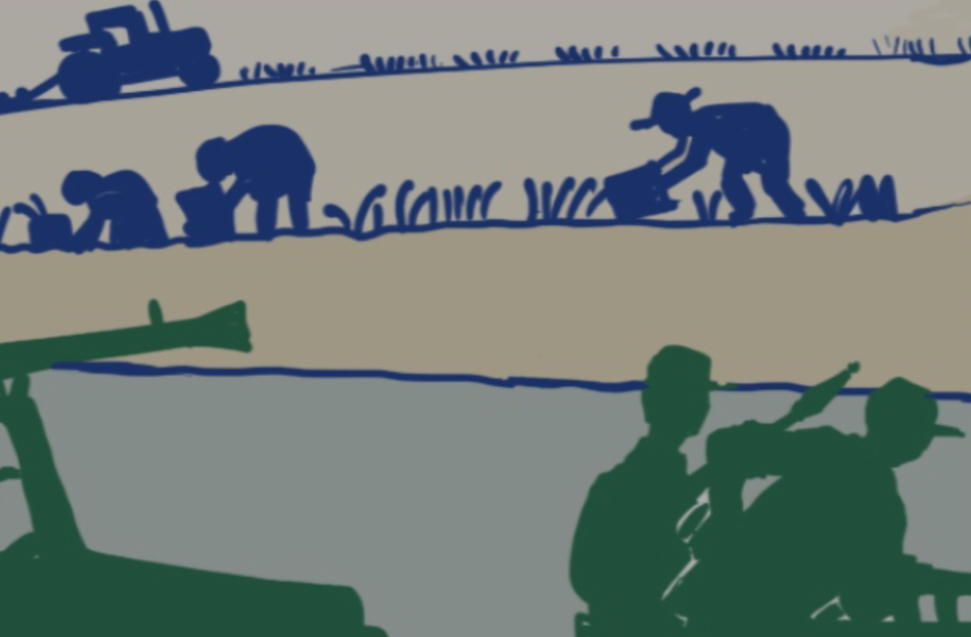
Training on the Practical Measures for Armed Actors to Prevent and Mitigate Conflict-Induced Food Insecurity
Module 5
Cooperation: Partners and Allies
Notes:
Notes:
Module 5: Cooperation: Partners and Allies
Note: modules 3-6 are primarily designed for armed actors.​
Time needed: 45-65 minutes​ (depending on it you use one or two exercises)
Set-up: free set up ​
Material: flip chart or similar available for note-taking​
Module objective: Participants understand what needs to be considered for the Practical Measures when they operate with partners and allies.

Slide 2

Learning objective module 5
Participants understand what needs to be considered to enhance food security when they operate with partners and allies.
02
Notes:
Notes:
Learning objective: ​
Explain that the objective of this module is that is that participants understand what needs to be considered for the Practical Measures when they operate with partners and allies.

Slide 3

Partner forces: concepts
“Armed actors who have formally agreed to partner with one another to achieve specific military aims in a conflict"
​
- Practical Measures document
03
Notes:
Notes:
Ask them what are partner forces for them ​
Explain that according to the Practical Measures document, partner forces are: "Armed actors who have formally agreed to partner with one another to achieve specific military aims in a conflict.”​
Ask them what is the difference between partners and allies?​
If it doesn’t come up, explain that the definitions of the concepts vary, but that allies usually imply a more formal (written) agreement, while partners and partnerships is used more loosely. ​
Background: ​
Ally:​ US definition: The term “allies” means any nation with which the United States is engaged in a common military effort or with which the United States has entered into a common defensive military alliance.​
Alliance: Alliances are formal agreements between two or more nations. In national defense, they're promises that each nation will support the other, particularly during war. (US) Example: NATO​
Partnerships: are less formal than alliances. Often called "strategic partnerships," they help build relationships between nations or organizations like militaries. Like alliances, they benefit the members of the partnership, but they can be short-term and don't involve a treaty. (US)​
Different use:​ France (Ministère des Armées: the ally is a state or non-state political entity that has made the strategic choice to commit itself, in unity with one or more other political entities, to an alliance in which “the conditions for the use of force (or threat of the use of force) against states an organizations outside the association” are defined.​
​
​
​

Slide 4



  Examples of alliances and partnerships?​
  How do they work?​
  What challenges and risks could they imply for the food security of the population?
Partners and allies
04
Notes:
Notes:
Note: depending on the actors you may have participating, these may be sensitive issues. Explain to them that they don’t need to specify who their partners and allies are, but that they can speak in more generic terms. Explain to them that this is a discussion that relates specifically to improving the food security of civilians and that you don’t gather this information for anyone. Make sure not to take notes to leave no written track. ​
Exercise 12A: Discussion (10 minutes discussion in plenary):​
Ask them if they have allies or partner forces or if they can give some examples​
Ask them how such cooperation works.​
Ask them what risks and challenges there may be when operating with partners and allies, specifically related to the food security of the civilian population.​
Ask them how such challenges and risks can be addressed.​
Listen to their inputs. No need to take notes as this may be sensitive information.

Slide 5

Good practice for preventing and mitigating civilian harm caused by partners and allied forces
  Assess partner’s capacity and will to prevent, minimize, and mitigate harm to civilians.​
  Encourage partners to develop and enforce adequate policies and practices.​
  Establish formal and informal agreements to define the scope, objective, responsibilities, and expectations of the partner/partnership. ​
  Regularly communicate on risks and trends associated with food insecurity caused by or occurring in the context of partnered operations. ​
  Ensure that credible allegations of civilian harm, including causing food insecurity, by partners are investigated.
05
Notes:
Notes:
Explain that armed actors should make every effort to ensure that partner and allied forces’ policies and behaviors align with their own standards regarding preventing and mitigating civilian harm, particularly conflict-induced food insecurity. ​
Consequently, armed actors should:​
Assess their partner’s capacity and will to prevent, minimize, and mitigate harm to civilians during operations and to ensure they meet civilians’ essential needs, particularly in terms of food security.​
Encourage partners to develop and enforce adequate policies and practices to respect international law relating to the protection of civilians and civilian objects, as well as preventing, mitigating, and addressing conflict-induced food insecurity.​
Establish formal and, where appropriate, informal agreements to define the scope, objective, responsibilities, and expectations of the partner/partnership. This should include a joint statement of principles and identify responsibilities to prevent, minimize, and mitigate civilian harm and food insecurity.​
Regularly communicate with partner forces on risks and trends associated with food insecurity caused by or occurring in the context of partnered operations as well as in partners’ own operations. Incorporate considerations related to civilian-harm mitigation and food security into all relevant stages of communication with partner forces, including planning, procedures, monitoring, training, information sharing, mentoring, and dialogue with partner forces.​
Ensure that credible allegations of civilian harm, including causing food insecurity, by partners are investigated. If proven that the partner force is accountable, require them to halt such actions, and ensure amends or redress is made. Pay specific attention to ensuring partner forces do not attack, degrade, destroy, seize, or deny civilians access to food.​
​

Slide 6
“When US military forces are operating with ally and partner forces, Department of Defense (DoD) Components will take steps to incorporate civilian harm mitigation and response considerations into planning and operations by:​
  Coordinating with ally and partner forces […] to synchronize and de-conflict operations; share intelligence, as appropriate and authorized; and develop plans and processes that incorporate civilian harm and mitigation considerations.​
  Incorporating civilian harm and mitigation considerations into operational and contingency plans, coalition campaigns plans, […] as well as exercises and engagements​
  Accounting for the risks of US military forces causing or contributing to civilian harm while conducting operations in support of ally or partner forces.​
  Prioritizing information sharing among ally and partner forces regarding civilians and civilian objects […]​
  Supporting allied and partner forces’ efforts to mitigate and respond to civilian harm […]
Example: ​
US DoD instruction on civilian harm mitigation and response, 2023
06
Notes:
Notes:
Explain that this section called "OPERATIONS WITH ALLIES AND PARTNERS" is drawn from the US Department of Defense instruction 3000.17 on civilian harm mitigation and response released in December 2023. Available: https://www.esd.whs.mil/Portals/54/Documents/DD/issuances/dodi/300017p.pdf
Ask participants what they think about this example and whether and how it could be relevant in their context. ​
​

Slide 7

Exercise: ​
Integrating food security into discussions with partners and allies
  What are the opportunities and risks of integrating food security into the discussions with partners and allies?​
  What would need to change:
    In the policies and practices of the partner/ally?​
    In the cooperation between your organization and the partner/ally?
07
Notes:
Notes:
Note: do this exercise for actors that are operating in partnership with other armed actors. ​
Exercise 12B (optional exercise – adds 20 minutes): Group work (10 minutes discussion in groups, 10 minutes discussion in plenary):​
Ask them to develop in their groups, based on what has been discussed, the US example, and their own experience, some bullet points to answer the following: ​
What are the opportunities and risks of integrating food security into the discussions with partners and allies?​
What would need to change ?
In the policies and practices of the partner or the ally?​
In the cooperation between your organization and the partner or ally?​
​

Slide 8

Module wrap-up & conclusions
08
Notes:
Notes:
Ask one or several of the participants to mention the most important things they learned/noted in the module. Take note on the flipchart or white board.​
​

Slide 9
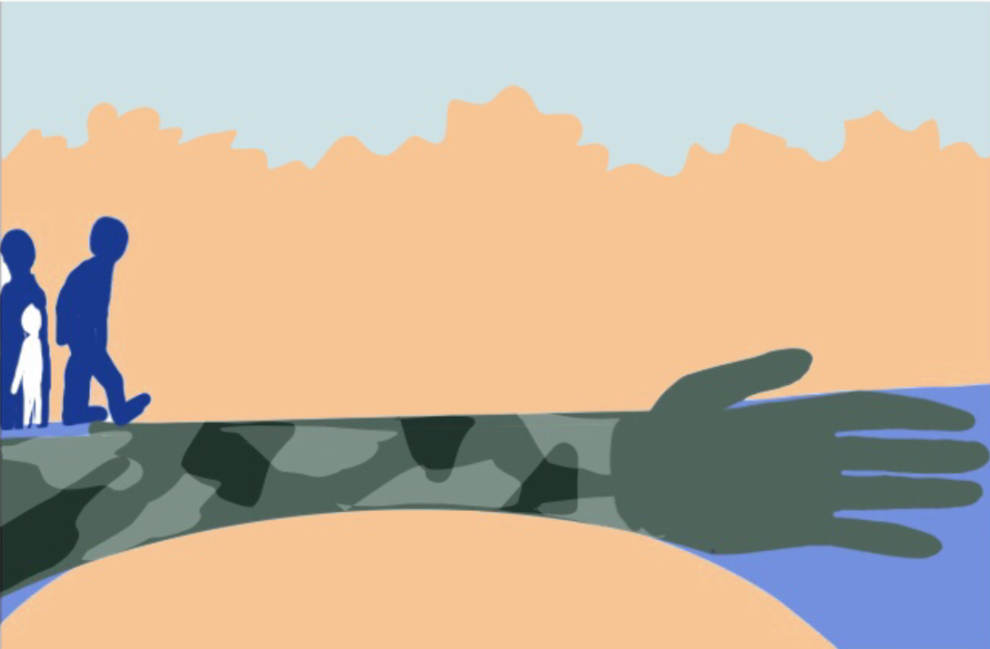
Questions ?
Notes:
Notes:
Address any questions or concerns raised by the participants.

