Slide 1
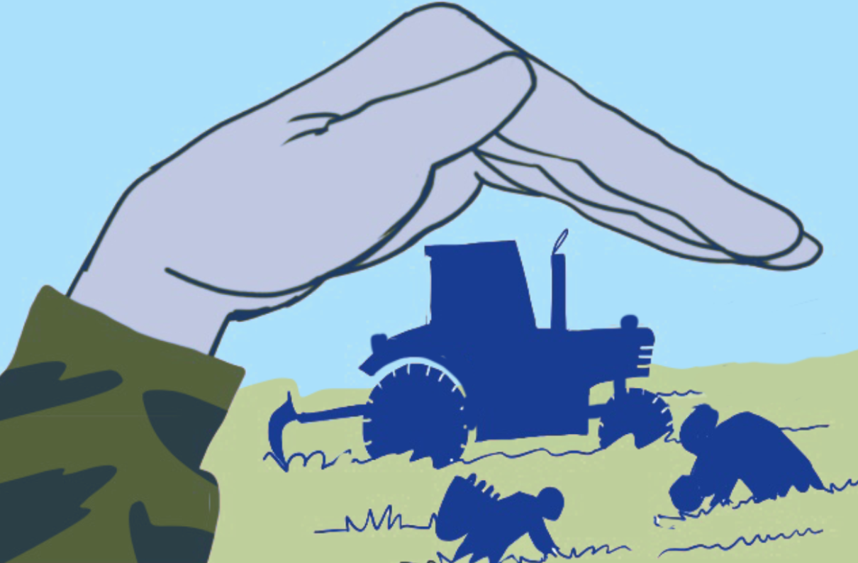
Training on the Practical Measures for Armed Actors to Prevent and Mitigate Conflict-Induced Food Insecurity
Module 2
The Practical Measures
Notes:
Notes:
Module 2, The Practical Measures

Slide 2

"The Practical Measures"
02
Notes:
Notes:​
Time needed for module for armed actors: about 140 minutes​
- Session 2: Introduction to the Practical Measures: 40 minutes​
- Session 3: Legal and Normative Framework of the Practical Measures: 60 minutes​
- (Lunchbreak)​
- Session 4: Content and purpose of the Practical Measures: 40 minutes​
Set-up: free set up, space for group work (three groups if possible)​
Material: flip chart or similar available for note-taking.​
Time needed for module for civil society: about 105 minutes​
- Session 2: Introduction to the Practical Measures: 40 minutes​
- Session 3: Legal and Normative Framework of the Practical Measures: 45 minutes
- Session 4: Content and purpose of the Practical Measures: 20 minutes​
Set-up: free set up, space for group work (three groups if possible)​
Material: flip chart or similar available for note-taking.​
​
​

Slide 3

Learning objective module 2
Participants are aware of the purpose, origins, and content of the Practical Measures, and recognize their relevance and usefulness in their context.
03
Notes:
Notes:
Learning objective: ​
Explain that the objective of this module is that is that participants are aware of the purpose, origins, and content of the Practical Measures, and recognize their relevance and usefulness in their context.​

Slide 4


Exercise: ​
Armed actors, communities, humanitarian actors, and food security
What are the roles of each of these groups related to food security in conflict:​
1. Communities?​
​
2. Humanitarian actors?​
​3. Armed actors? ​
04
Notes:
Notes:
Exercise 2 (group work): 30 minutes​.
This exercise builds on mapping exercise 1A in module 1 Mapping the food insecurity landscape.​
Even or specifically if you’re training armed actors, it has a value to have them also do the groups focusing on civil society or humanitarian actors, so that they understand, as well their roles and to some extent their needs.
Start out the module by asking the participants how they perceive the role of different actors in food security – in a positive or negative way – in their contexts. ​
Ask them to split into three groups, according to three different types of actors (communities, humanitarian actors and armed actors), and to answer to the following question: What are the roles of each of these groups related to food security in conflict?
You can detail the questions more and make them more targeted for each group:​
- Group 1: How can communities contribute to ensuring food security? When doing so, what are the risks they may face? Do they have any specific limitations to what they can do?​
- Group 2: What is the role of humanitarian actors in ensuring food security? What are the risks they may face? What are the needs of the humanitarian actors in order to operate? Also, do humanitarian actors have any limitation to what they can do? Why?​
- Group 3: What is the role of armed actors in conflict-induced food insecurity in the target context? How can their actions affect food security, positively and negatively? ​
Give them about 10 minutes to discuss and prepare some bullet points. 1-2 persons from each group gives a recap of the discussion.
​Go through their answers with them, take about 20 minutes for the discussion in plenary.​
- For communities: some coping strategies of the communities may come up. These may include negative strategies, such as child labor and sex work. It is important to highlight that communities can play a positive role in solving problems that affect them.​
- For humanitarian actors: make sure that the issue of mandate and humanitarian principles come up. They might not be fully aware that humanitarian actors have some limitations that are beyond them, due to their mandate, their operating principles, the nature of their funds, security considerations, etc. ​
- Armed actors: see if they have mentioned mainly negative or positive roles for the armed actors. If they mentioned mainly negative roles, ask them: What is or could be the role of armed (and related political) actors in ensuring food security in their context? Explain that this is at the core of this training. The role of the State and different political and humanitarian instances will mostly come up. Confirm that this is very important, but make sure to stress that the Practical Measures are meant for armed actors.

Slide 5


"Practical Measures"
An initiative led by humanitarian actors.​
A guidance tool for armed actors to help them better prevent and mitigate conduct that would result in conflict-induced hunger
An advocacy tool for humanitarian, civil society and diplomatic actors to engage in more targeted negotiation with armed actors
05
Notes:
​Notes:
Explain that the “Practical Measures” initiative has been undertaken by a number of humanitarian actors and led by InterAction to cover a gap in supporting efforts to combat conflict-induced food insecurity. ​
The initiative produced a tool called “Practical Measures” to help armed actors – and the humanitarian, civil society and diplomatic communities that engage with them – to address conflict-induced hunger. ​
- For armed actors it is a guidance tool to help them better prevent and mitigate conflict-induced food insecurity.​
- For humanitarian, civil society and diplomatic actors it is an advocacy tool to engage in more targeted outreach and negotiation with armed actors.​
​The Practical Measures initiative echoes previous work initiatives such as the Safe School Guidelines and Protecting Healthcare: Guidance for the Armed Forces. ​
​

Slide 6

Process
2022: Creation of a Steering Committee and drafting of the “Practical Measures” tool
​2023: Consultations with States (including militaries), UN agencies, NGOs, academics, affected communities, non-State armed groups, and de facto authorities.
2024: Launch of the “Practical Measures for armed actors to prevent and mitigate conflict-induced food insecurity”
05
Notes:
​Notes:
Explain that the process started in 2022 with a scoping meeting of 45 protection and food security actors, followed by the set up of a Steering Committee. The Steering Committee was responsible the drafting of the document.​ It was composed of experts in the areas of food security, protection, and IHL, as well as military practitioners. It reached consensus on the key purpose, and structure of the process, as well as the content of the document. ​
The consultation phase took place in 2023, and consultations were held with States, non-State armed groups and other key stakeholders for food security. ​Between January and March 2023, consultations on successive drafts of the “Practical Measures” tool began with States. ​The primary focus was members of the Group of Friends (GoFs) for Action on Conflict and Hunger. Eight member countries of the GoFs provided feedback. ​From April to December 2023, further consultations took place with a broad range of stakeholders, including non-State armed groups, affected communities, civil society organizations, the Red Cross/Crescent movement, international NGOs, UN agencies, local authorities, national armed forces, and the diplomatic and donor communities. ​
May 2024 saw the launch of the Practical Measures:​ based on these multi-stakeholder consultations and additional feedbacks, the “Practical Measures” tool was finalized and launched publicly on 6 May 2024.
The document is available in four languages: Arabic, English, French, and Spanish. ​
Background:​
Affected communities were consulted in Cameron, Chad, and Nigeria.​
Consultations with non-state armed groups took place in four countries (Colombia, Mali, Myanmar, and Syria).​ ​

Slide 7

Key sources of international law
07

Slide 8


International Humanitarian Law (IHL)
Resources:​​​
​
  ICRC, Starvation, Hunger, and Famine in Armed Conflict: An Overview of Relevant Provisions of International Humanitarian Law​​​
  UNOCHA, Hunger and armed conflict: IHL Framework​​​
  OHCHR & FAO, The Right to Adequate Food​​​
International Human Rights Law (IHRL)
International Criminal Law (ICL)
UN Security Council (UNSC) Resolutions
08
Notes:
Notes:​
Note: The following five slides explain the legal framework in some detail. Depending on the level and interests of the participants you may want to cut or expand this part of the module.​
For civil society it is calculated that the legal framework will be done in about 45 minutes, while for armed actors 60 minutes could be dedicated to this. ​
Ask participants about some of the acts related to food insecurity they think should be prohibited for armed actors under international law. ​
Then review key sources of international law:​
- IHL, also known as the Law of Armed Conflict, applies in times of armed conflict. It establishes a set of rules which seek to protect persons who are not, or no longer, participating in the hostilities and regulates the means and methods of warfare. All parties to an armed conflict – either states or organized non-State armed groups – are bound by IHL. ​
- IHRL establishes a set of rules that seeks to protect the fundamental rights of all human beings. It applies at all times, whether an armed conflict exists or not. It is primarily States that must respect, protect and fulfil human rights. The extent to which non-State armed groups are bound by IHRL is debated. There is a growing consensus however, that organized armed groups exercising government-like functions and control over a given territory and population (‘de facto authorities’) also have human rights responsibilities.​
- ICL deals with the criminal responsibility of individuals for the commission of particularly serious violations of international law: war crimes, crimes against humanity, genocide and the crime of aggression.​
- UNSC resolutions are decisions adopted by a vote of the Security Council, the UN organ charged with ensuring international peace and security. The nature of the resolution determines if it is considered binding on Member States. In general, resolutions adopted by the Security Council acting under Chapter VII of the UN Charter, are considered binding.​
​
​
​
​

Slide 9

International Humanitarian Law (IHL)
Conduct of hostilities:
  IHL prohibits the use of starvation of civilians as a method of warfare​
  IHL prohibits attacking objects indispensable to the survival of the civilian population​
  IHL rules of distinction, proportionality and precautions in attack provide protection to civilian objects, including infrastructure, land and other objects that contribute to civilian food supply. ​
  IHL prohibits or restricts the use of a broad range of weapons that can have widespread and long-lasting impact on food security ​
  No part of the natural environment may be attacked
  IHL imposes significant restrictions to sieges.​​
09
Notes:
​Notes:
Explain that many IHL rules are relevant to ensuring food security and preventing starvation in situations of armed conflict. Parties to conflict must respect several obligations designed to preserve sources of food and livelihoods and protect civilians from food insecurity. ​
​Rules related to the conduct of hostilities​:
1) In order to safeguard the civilian population’s access to food in armed conflict, IHL prohibits starvation as a method of warfare. To use starvation as a method of warfare is to provoke it intentionally, causing the population to suffer hunger by depriving it of sources of food or supplies. Denying access of humanitarian aid intended for civilians in need, including by deliberately impeding humanitarian aid or restricting the freedom of movement of humanitarian relief personnel, can constitute violations of the prohibition of starvation.​
2) Related to the rule on starvation, IHL prohibits attacking, destroying, removing or rendering useless objects indispensable to the survival of the civilian population. Such objects include foodstuffs and agricultural areas for their production, crops, livestock, drinking water installations and supplies, and irrigation works. This list of protected objects is not exhaustive. The rule should be interpreted widely to cover the variety of needs of populations. ​
3) More generally, the IHL rules of distinction, proportionality and precautions in attack also serve to protect civilians and civilian objects such as land and infrastructure. In addition to prohibiting attacks directed against civilian objects, IHL prohibits attacking a military objective if the expected incidental civilian death, injury or damage exceeds the military advantage anticipated. IHL also requires that parties take constant care to spare civilians and civilian objects in the conduct of military operations and take all feasible precautions to avoid and minimize incidental loss of civilian life, injury to civilians and damage to civilian objects.​
4) IHL prohibits or restricts the use of a broad range of weapons that can have widespread and long-lasting adverse impact on food security. These include prohibitions against the use of poison and biological and chemical weapons, and restrictions on the use of herbicides as a weapon. Anti-personnel mines, cluster munitions and nuclear weapons are also subject to prohibitions and restrictions under IHL.
5) No part of the natural environment may be attacked, given its underlying civilian character, unless, in specific circumstances, when a part of it has become a military objective.
6) IHL imposes significant restrictions in relation to sieges and encirclements. Civilians must not be trapped in sieges, and parties to conflict must allow civilians to leave a besieged area. Naval blockades are prohibited if their purpose is to starve the civilian population or deny it other objects essential for its survival.

Slide 10
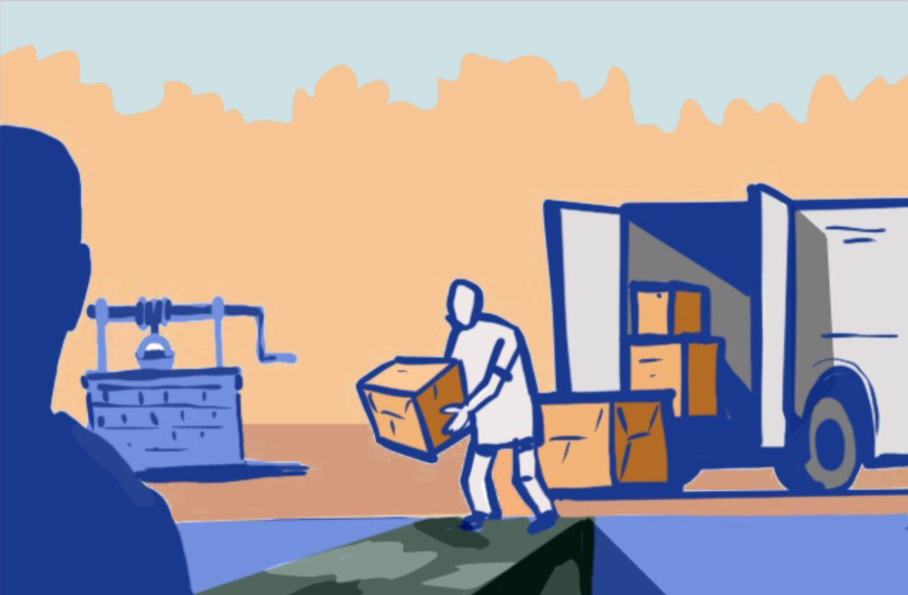
IHL (Continued)
Food security and humanitarian access:
  IHL obliges parties to conflict to ensure that adequate supplies of food and water are available to the civilian population​
  If they cannot meet these needs, parties to conflict must allow and facilitate rapid and unimpeded passage of humanitarian relief ​​
10
Notes:
​Notes:
Rules related to food security and humanitarian access:​
1) Each party to armed conflict has primary responsibility for ensuring that the basic needs of the population under its control are met, including adequate supplies of food and water.​
2) Humanitarian relief can also play a vital role in averting and addressing hunger. If they cannot meet the needs of the population, parties to the conflict must allow and facilitate rapid and unimpeded passage of impartial humanitarian relief for civilians in need, subject to their right of control. The parties must also ensure the freedom of movement of humanitarian personnel that is essential to their functions. Humanitarian activities or movements can only be restricted in case of imperative military necessity, and only temporarily. Relief personnel and objects used for relief operations must be respected and protected. Attacks, harassment, intimidation, and arbitrary detention of relief personnel, and destruction, misappropriation and looting of relief objects, are prohibited.​

Slide 11

International Human Rights Law (IHRL)
Food is a basic human right!
  The right to adequate food is recognized in the Universal Declaration of Human Rights, as well as in several other international conventions​​
  IHRL requires states and arguably de facto authorities to take steps indispensable for the fulfillment of a population’s essential needs, including in terms of access to food ​​
11
Notes:
​Notes:
Explain that:​​
The right to food, and water, is a fundamental right recognized by IHRL. The Universal Declaration of Human Rights recognizes that: “Everyone has the right to a standard of living adequate for the health and well-being of himself and of his family, including adequate food, ...” (art. 25) ​
The International Covenant on Economic, Social and Cultural Rights, which is part of the International Bill of Human Rights, recognizes the right to adequate food as an essential part of the right to an adequate standard of living (art. 11 (1)). It also explicitly recognizes “the fundamental right of everyone to be free from hunger” (art. 11 (2)). ​
The right to food is also recognized in other international conventions protecting specific groups, such as the Convention on the Elimination of All Forms of Discrimination against Women (1979), the Convention on the Rights of the Child (1989), and the Convention on the Rights of Persons with Disabilities (2006).​
IHRL requires States and arguably de facto authorities to take steps indispensable for the fulfillment of a population’s essential needs, including in terms of access to food. Under the International Covenant on Economic, Social and Cultural Rights (ICESCR), states parties have an obligation to take steps, individually and through international cooperation, indispensable for the survival of a population, including in terms of access to food and health care. ​

Slide 12
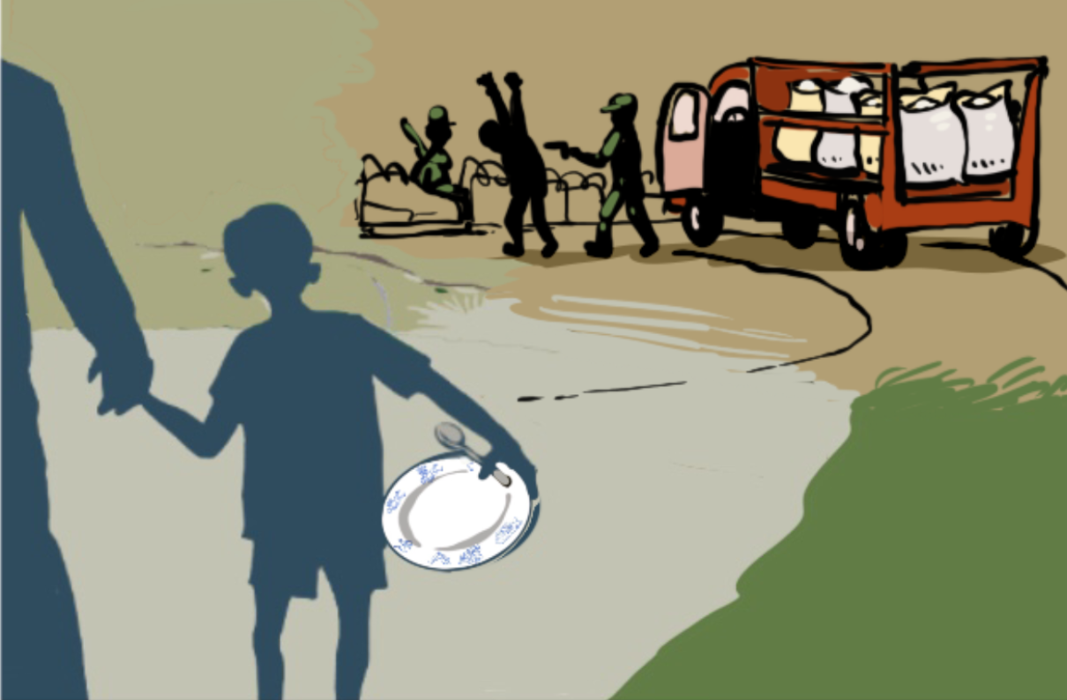
International Criminal Law
Under the Statute of the International Criminal Court:
  Intentionally starving civilians as a method of warfare is a war crime​
  Intentionally attacking humanitarian personnel and objects may also constitute a war crime ​
  Deliberate starvation may also constitute genocide or a crime against humanity ​
12
Notes:
Notes:
Explain that under the Rome Statute of the International Criminal Court (ICC):​
Intentionally starving civilians as a method of warfare is a war crime. This prohibition applies to both situations of international and non-international armed conflicts. The prohibition applies to blockades and sieges. ​
Intentionally attacking humanitarian personnel and objects may also constitute a war crime. ​
The denial of humanitarian assistance and intentional deprivation of food, whether in war or peace, may amount to the crime against humanity of extermination and in extreme cases even genocide.​

Slide 13
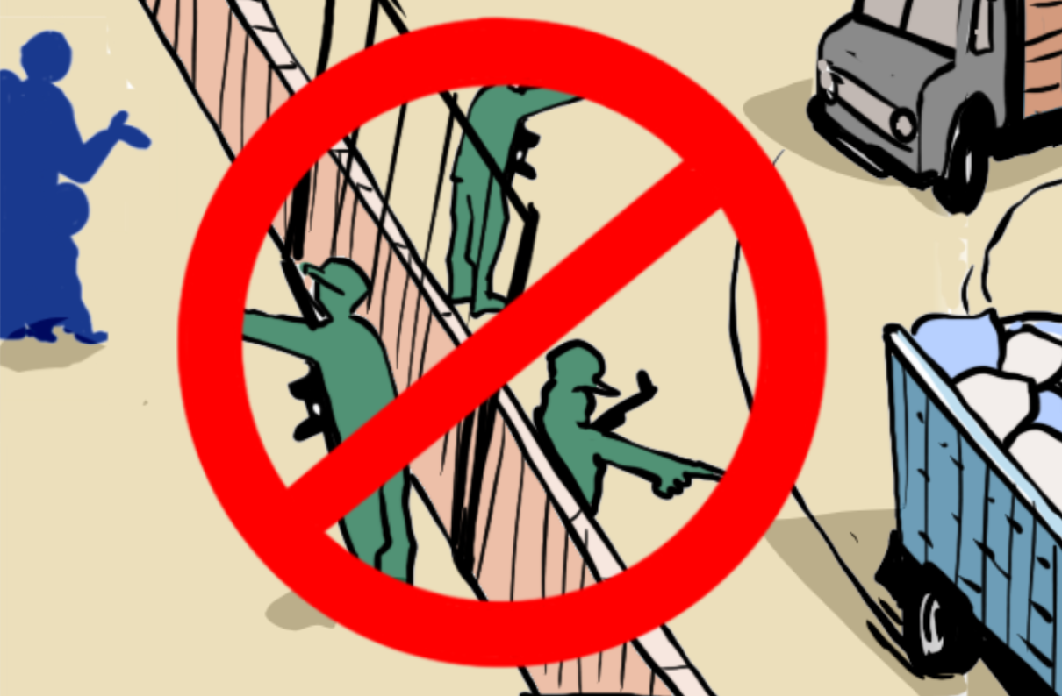
UN Security Council Resolutions
UNSC 2417 (2018)​
Recognizes conflict-induced hunger as a threat to international peace and security​.
Calls on parties to conflict to respect IHL rules that aim to protect against hunger
UNSC 2573 (2021)​
Recalls that indiscriminate and disproportionate attacks that result in depriving the civilian population of objects indispensable to their survival are flagrant violations of IHL
13
Notes:
​Notes:
Explain that there are a number of UN Security Council Resolutions that are addressing food security, usually focusing on hunger.​
UNSC 2417​
In May 2018, the UN Security Council unanimously adopted Resolution 2417 in response to its deep concern about the level of global humanitarian needs and the threat of famine facing millions of people in armed conflicts, and about the number of undernourished people in the world. ​
Resolution 2417 recalls the link between armed conflict and hunger and acknowledges that peace is directly threatened when hunger emerges from armed conflict. ​
Resolution 2417 recognizes that using starvation as a method of warfare can constitute a war crime​.
Resolution 2417 also restates the range of IHL rules that aim to protect against hunger, calling on all parties to conflict to respect them, and on those with influence over parties to remind them of their obligations.​
Resolution 2417 also requests that the Secretary-General report: i) annually on its implementation, ii) regularly on the risk of famine and food insecurity in his country reports, and iii) swiftly to the Council when the risk of conflict-induced famine and wide-spread food insecurity in armed conflict contexts occurs. ​
UNSC 2573​
In 2021 the UNSC also unanimously adopted Resolution 2573, its first resolution recalling that indiscriminate and disproportionate attacks that result in depriving the civilian population of objects indispensable to their survival are flagrant violations of IHL.

Slide 14



Which bodies or institutions are in charge of
(1) developing and
(2) implementing these framework(s)?
What are the most relevant legal and normative frameworks in your context?
14
Notes:
Notes:
Exercise 3: (10 minutes in plenary or small groups)​
Explain to them that now that you have discussed the international framework it would be interesting to hear from them how this relates to/is reflected in the framework where they are operating. You can either do this in plenary, or in small groups. ​
In small groups: (adds 5-10 minutes of time, so total around 15-20 minutes) ​
Ask them to divide into small groups (3-4 people) and take 5-10 minutes to identify and list the most relevant legal and normative frameworks regulating food security in their contexts.​
Ask which bodies or institutions are in charge of developing and implementing these frameworks.​

Slide 15

Content and purpose
15

Slide 16
Key areas of the Practical Measures
1
2
3
4
Policies and practices for Civilian Harm Mitigation​
Considerations for planning and conducting military operations​
Partners and allies​
Addressing harm caused​
16
Notes:
Notes:
Explain that as mentioned before, the Practical Measures are designed to help armed actors better comply with their legal obligations and reduce civilian harm from operations. Complying with IHL is the minimum that armed actors must do. The document lays out the policies, practices, and major considerations that armed actors should incorporate into their analysis, planning, operations, and post-operations that are necessary to mitigate civilian harm, specifically their impact on food security.​
In terms of content, there are four key areas, that are complementary with each other and reinforce the measures taken in the other areas: ​
1) Policies and practices for Civilian Harm Mitigation
Armed actors should have in place policies, guidance, and procedures aimed at preventing, mitigating and responding to civilian harm, including conflict-induced food insecurity. ​
2) Considerations for planning and conducting military operations
When planning and conducting operations, armed actors should consider their potential impact on civilians and civilian objects to avoid causing or increasing food insecurity. ​
3) Partners and allies​
Armed actors should make every effort to ensure that partners and allied forces align with their own standards regarding preventing and mitigating civilian harm, including conflict-induced food insecurity.​
4) Addressing harm caused​
Armed actors should take all feasible steps to address the harm caused by their actions or omissions, in consultation with affected people. ​

Slide 17
Practical measures “The Do’s”
Practical measures “The Don’t’s”
  Act as a guidance and reference tool.​
  Duplicate IHL obligations
  Create an accountability or monitoring tool​
  Focus on armed actors, including State armed forces, non-State armed groups, etc.​
  Require a political sign-on
  Identify concrete steps that armed actors can take to prevent or mitigate conflict-induced food insecurity.​
  Focus on the behaviour of political actors.​
  Aspire to quickly change behaviour of actors purposefully using starvation as a method of war.​
  Raise the bar on standard practice.
17
Notes:
Notes:
Explain that the Practical Measures are:​
a guidance and reference tool for State and non-State armed groups who would otherwise unwittingly contribute to food insecurity. ​
rooted in civilian harm-mitigation and response good practice, therefore reflecting and complimenting IHL and IHRL.​
concrete steps that armed actors can take to prevent or mitigate conflict-induced food insecurity.​
a collective effort to raise the bar on standard practice. As such, some of the measures are aspirational and can be progressively realized.​
Explain that they are not:​
the go-to document for understanding one’s IHL obligations: while some IHL obligations are reflected in the document, this is not comprehensive​.
a monitoring or accountability tool.
Nor is it a political declaration that requires sign-on.​
As such, it does not focus on the behavior of political actors.​
Lastly, it is not expected that the Practical Measures will influence the behavior of those purposefully using starvation as a method of war.​
​

Slide 18
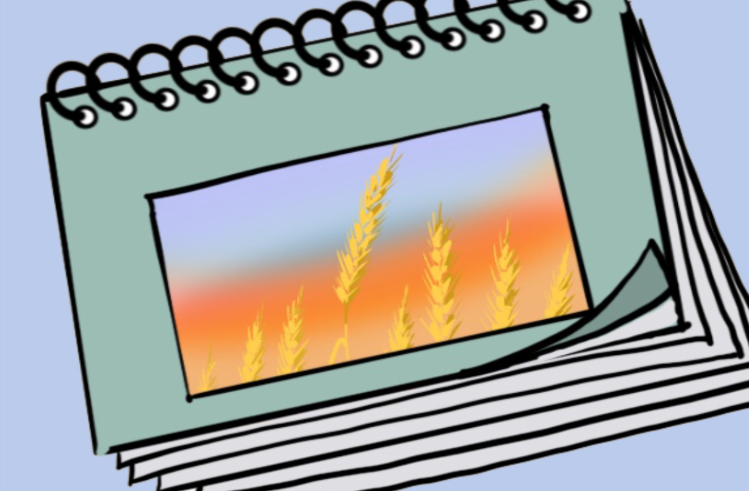
Exercise: ​
Exploring the potential of the Practical Measures
  What could be the use of the Practical Measures in your context ?
2. What could be the benefits if the Practical Measures were implemented ?​
18
Notes:
Notes:
For armed actors you do this exercise as an introductory brainstorming exercise. ​
For civil society you can chose to not do it here, but to expand it instead in the final module.​
Exercise 4 (groups): (20 minutes)​
Explain that now that you have discussed what the Practical Measures are meant to be and not, you would like them to consider what use they could find of them in their specific context. ​
Ask them to split into smaller groups, it could be the same is Exercise 2: focusing on armed actors, communities and humanitarian actors. Each group should come up with at least one potential use and one potential benefit for these actors of the Practical Measures tool in their context. ​
Leave the slide with the content on, as this can give them an idea what concrete issues the actions could relate to.​
​You can either have all of them focus on armed actors or keep the division of: ​
- Communities – what use could communities make of the Practical Measures? What could be the benefits for communities if the Practical Measures are implemented in their context?
- Humanitarian actors – what use could humanitarian actors make of the Practical Measures? What could be the benefit for humanitarian actors if the Practical Measures are implemented where they are operating? ​
- Armed actors – what could be the use of the Practical Measures for armed actors in their contexts? What could be the benefits for armed actors if they implement the Practical Measures?
While in armed actor training, just like in exercise 2, there could be an advantage to have more people working on their own perspective, it could also be of use to have the members of the armed actors putting themselves in the shoes of the communities and humanitarian actors respectively to think about what use they could make of the tool and how it could benefit them. ​
There may be no need to have a detailed presentation of all ideas (they can either present 1-2 ideas each or the facilitator reads on their flipcharts). ​
Say that you will return to this discussion particularly the second day. ​
​
​
​
​
​

Slide 19

Module wrap-up & conclusions
19
Notes:
Notes:
Ask one or several of the participants to mention the most important things they learned/noted in the module. Take note on the flip chart or white board.​

Slide 20
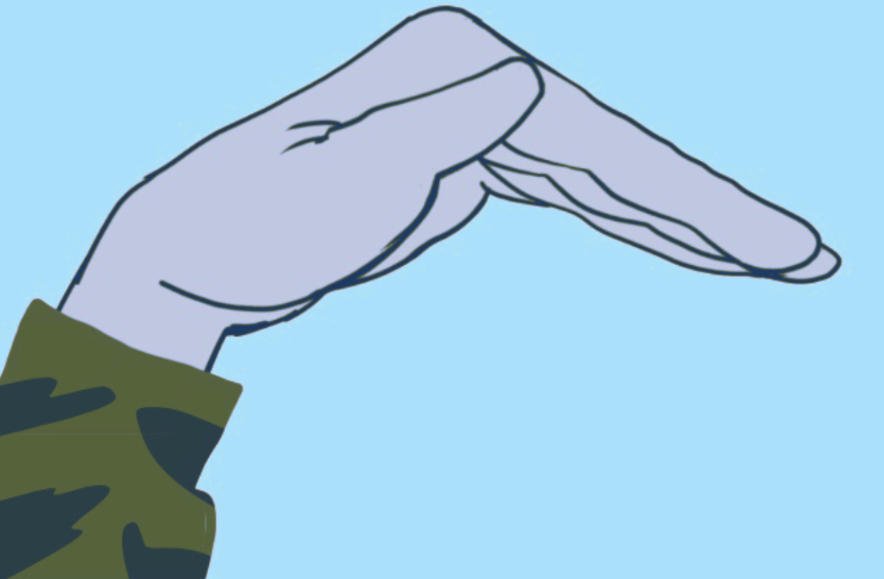
Questions ?
Notes:
​Notes:
Address any questions or concerns raised by the participants.

