Slide 1
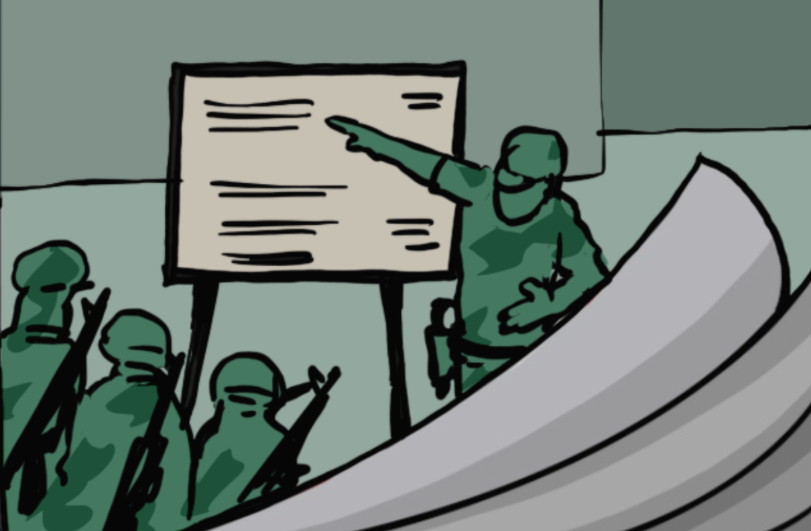
Training on the Practical Measures for Armed Actors to Prevent and Mitigate Conflict-Induced Food Insecurity​
Module 3
Preparations: Foundations of Civilian-Harm Mitigation ​
​
Notes:
Notes:
Module 3: Preparations: Foundations of Civilian Harm Mitigation
*Please note that the cover page should vary depending on the content of the training. Remember to change the title accordingly when you prepare the training.
​

Slide 2
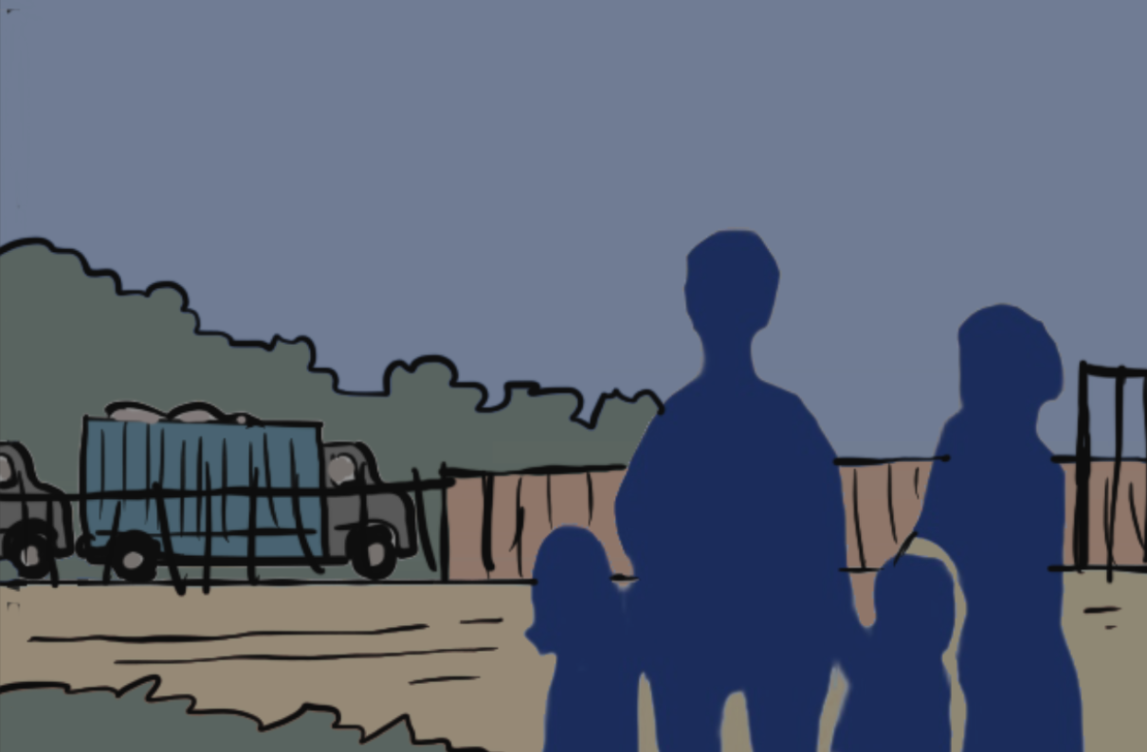
Preparations: Foundations of Civilian-Harm Mitigation​
02
Notes:
Notes:
Modules 3-6 are primarily designed for armed actors.
Parts of module 3 are still recommended to be integrated into the trainings for civil society and proposals are made for how to modify the module accordingly.
Set-up: circle set up, if possible, flip chart or similar available for note-taking.
Material: print-outs of the code of conduct for exercise 5 (see Annex 2.C)
Time needed for module for armed actors: about 140 minutes
- Session 5: Civilian harm mitigation policies: 60 minutes
- Session 6: Humanitarian assistance policy: 35 minutes
- Session 7: Personnel, resourcing, and training and Monitoring, learning and applying lessons learned: 45 minutes
(+ Day one closing: 15 minutes)
Set-up of closing session (for armed actors only): preferable in a circle, sitting or standing
Material: an object to pass around for the check-out circle
Time needed for module for civil society: about 95 minutes
- Session 5: Civilian harm mitigation policies: 35 minutes
- Session 6: Humanitarian assistance policy: 30 minutes
- Session 7: Personnel, resourcing, and training and Monitoring, learning and applying lessons learned: 30 minutes
Explain that now that you have covered conflict-induced food insecurity and what the Practical Measures are, it is time to look at each of the four key areas in some more detail, before moving into the reflections on what can be done with them.
Remind them that the four key areas are:
Framework for Civilian Harm Mitigation
Measures to Prevent Conflict-Induced Food Insecurity in Operational Contexts
Partners and Allies
Addressing Harm Caused

Slide 3

Learning objective module 3
Participants understand the main preparation aspects that can be taken for implementing the Practical Measures and are able to apply this to their own organization.
03
Notes:
Notes:
Learning objective:
Explain that the objective of this module is that participants understand the main preparation aspects that can be taken for implementing the Practical Measures and are able to apply this to their own organization.

Slide 4
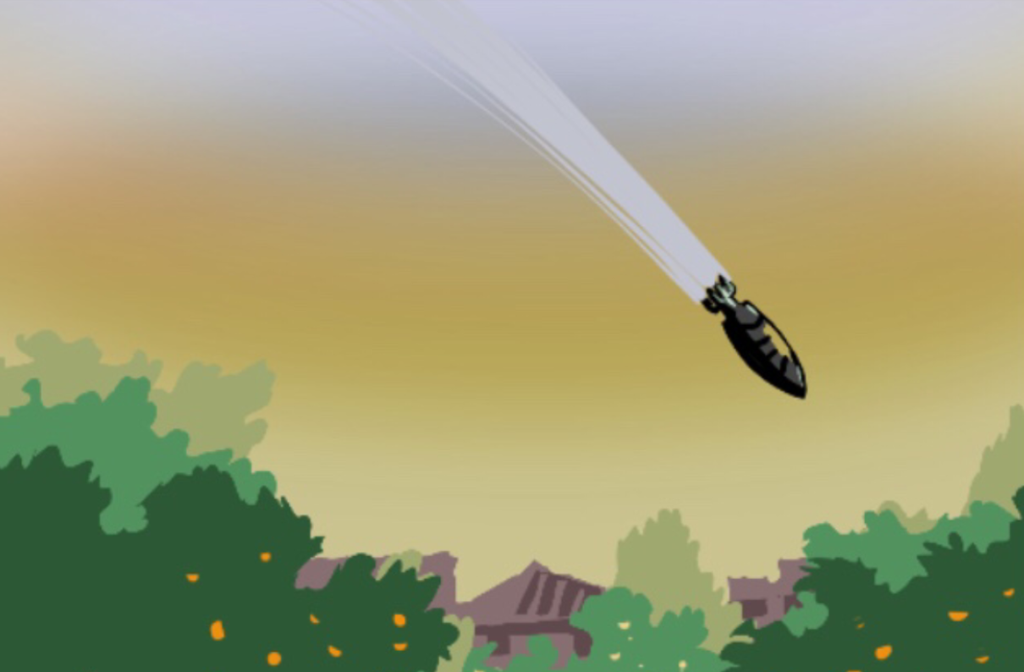
Civilian harm
"All negative effects on civilian personal or community well-being caused by the use of force in hostilities, as well as actions taken by soldiers or units outside of combat."​
​
— Practical Measures document
04
Notes:
Notes:
Remind them of the definition of civilian harm that you looked at before in the first module, as: ​"All negative effects on civilian personal or community well-being caused by the use of force in hostilities, as well as actions taken by soldiers or units outside of combat."​
Stress that mitigating civilian harm is at the very core of the Practical Measures, as mentioned before, especially in relation to food security.​
​Background notes from before:​
The effects (the civilian harm) can occur: ​
directly: through death, physical or mental trauma, property damage or ​
indirectly: through the destruction of critical infrastructure, disruption of access to basic needs and services, or the loss of livelihood.​
​

Slide 5
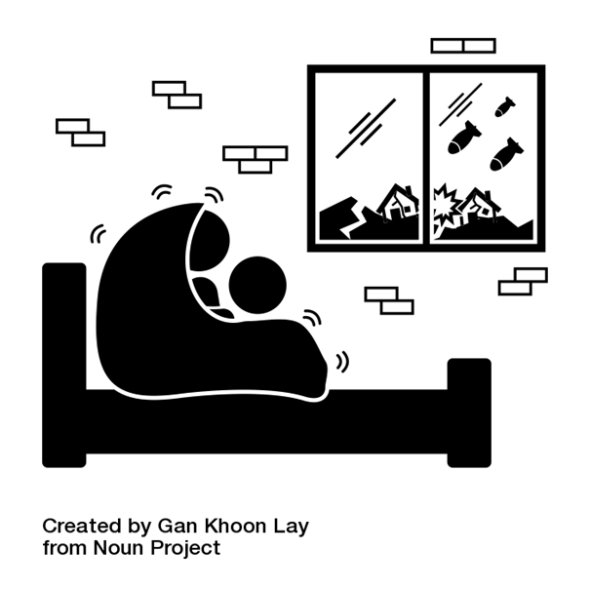
Civilian harm mitigation
”All measures taken by armed actors to prevent, minimize, and address civilian harm resulting from their operations."​
​
— CIVIC
05
Notes:
Notes:
Provide them with CIVIC’s definition of civilian harm mitigation as:​ ”all measures taken by armed actors to prevent, minimize, and address civilian harm resulting from their operations."​
​Explain that, as previously mentioned, it is the responsibility of armed actors to meet their legal obligations and to effectively protect civilians.​ In order to do so, they have to do all they can to mitigate civilian harm, and this includes preventing and mitigating conflict-induced food insecurity. ​
Explain that civilian mitigation for food security should be applied along with broader policies and practices aimed at protecting civilians, mitigating civilian harm, and ensuring compliance with IHL.​
​Ask them how they think that this is best done, in which areas or what types of measures could be taken.​
Listen to their answers and then show the text on the next slide.​
​
​
​
​

Slide 6


Areas of civilian-harm mitigation policies:
Civilian-harm mitigation policies
Humanitarian assistance policies
Issues related to personnel, notably resourcing and training of staff and
Monitoring, learning and applying lessons learned
06
Notes:
Notes:
Explain that civilian harm mitigation requires that armed actors integrate civilian-harm mitigation and protection in their: ​
- policies, ​
- training, and ​
- internal accountability mechanisms. ​
Explain that in this module we look at the framework for civilian harm mitigation from a preparatory or preventive perspective and we will break it down into the following four areas:​
- Civilian-harm mitigation policies​
- Humanitarian assistance policies​
- Issues related to personnel, notably resourcing and training of staff and​
- Monitoring, learning and applying lessons learned relating to civilian harm mitigation​
Background:​
The question might come up on the relation to protection of civilians. ​
You can mention that protection of civilians is a cornerstone of IHL and means that civilians and civilian objects may not be deliberately targeted and on the contrary must be protected from violence and treated humanely. ​
Protection of civilians (PoC) has a requirement to take proactive action to protect civilian from one’s own action for example in attacks, when conducting operation, but also in defense or generally from the actions of other conflict parties and from situations that may expose them to danger and risks. This can be both in the capacity as conflict party (for example to avoid locating one’s own military objects and staff close to civilian objects and populations) or in a peacekeeping role (for example UN peacekeeping missions often have PoC mandates). ​It also means ensuring adequate humanitarian relief to people in need, such as food, clothing, shelter, and medical treatment.​
See for example CIVIC https://civiliansinconflict.org/wp-content/uploads/2022/07/CIVIC_Primer_CivilianHarm_Mitigation_UrbanWar.pdf.

Slide 7

Current issues and trends in civilian harm mitigation
07
Notes:
Notes:
Current issues and trends in civilian harm mitigation: ​
Urban warfare is introducing new and significant challenges (see for example https://civiliansinconflict.org/wp-content/uploads/2022/07/CIVIC_Primer_CivilianHarm_Mitigation_UrbanWar.pdf and https://shop.icrc.org/war-in-cities-preventing-and-addressing-the-humanitarian-consequences-for-civilians-print-en-1.html
If this concept is relevant in the context where you are giving the training you can choose to show the video “How can fighters reduce civilian harm in urban warfare?” by the ICRC (until about minute 1.03) or a similar video, especially for non-State armed groups https://youtu.be/otDk9tuu6_w or “War in cities, the impact on civilians,” also by the ICRC https://youtu.be/iXO2Wv2WpDg.
Explain that the concept of civilian harm mitigation has been expanding beyond preventing casualties (persons killed or injured) to broader direct and indirect harm such as foreseeable consequences, for example on civilian infrastructure.​
The concept has been expanding beyond what is required in the law (IHL)​
Example: US Department of Defence released a comprehensive civilian harm mitigation policy in December 2023.
Available: https://www.esd.whs.mil/Portals/54/Documents/DD/issuances/dodi/300017p.pdf. Important point from this policy: the need to consider alternatives to an attack to military targets even if lawful, if there is a risk of civilian harm, and to take “other precautions not required by the law of war.” ​
They also developed an action plan with clear objectives and phases for the implementation of the policy: https://media.defense.gov/2022/Aug/25/2003064740/-1/-1/1/CIVILIAN-HARM-MITIGATION-AND-RESPONSE-ACTION-PLAN.PDF ​
​

Slide 8
Civilian-harm mitigation policies
1
2
3
Codes of conduct
Rules of engagement
Military doctrine and instructions, etc.
08
Notes:
​Notes:
Explain that we will go through these areas one by one, starting with civilian harm mitigation policies.​
Tell them that we saw that some actors (the US) have dedicated civilian harm mitigation policies, but civilian harm mitigation can also be found in other policies.​
Ask them if they know where civilian harm mitigation policies can be found in their own context and if they have some examples.​
Listen to them, and then show some areas where civilian harm mitigation policies can be found, for example in:​
- codes of conduct​
- rules of engagement​
- military doctrine and instructions, etc.​
​Ask how these work and what their specificities are according to them.​
Explain that these are all different policies, guidance, and procedures that reflect applicable law (for example, IHL, IHRL, and other normative frameworks) ​
Their focus is on the importance of preventing, minimizing, and responding to civilian harm. ​
They provide guidance on the actions, training, and enforcement procedures that are necessary to allow armed actors to effectively anticipate, prevent, minimize, mitigate, and respond to civilian harm, including conflict-induced food insecurity. ​
Background:
Codes of conduct:
They are “documents that, albeit different in length and form, contain at their core lists of rules and responsibilities that armed groups’ hierarchies set out for their members” IRRC 2011
They aim to regulate both the members’ internal behaviour and their relations outside the group. ​
Part of the “professionalism” and/or “organization” of the armed forces – to have professionally trained and disciplined armed forces ​
Command responsibility for potential violations committed by the subordinates ​
Have a mainly internal purpose, but can be used for external communication​
Seen by international community as a tool for the respect of IHL.​
The drafting process can help with internal reflections on existing violations and how to prevent/end them. ​
Minimum requirement: Common Article 3 of the Geneva Conventions​
Rules of engagement (ROE):​
They are military directives, or the rules that govern the use of force to reflect the will of a civilian and military leadership.​
They are not law of armed conflict or international humanitarian law (IHL), nor domestic law. ​
They play a significant role in executing the state's IHL obligations. ​
Most States' armed forces have some version of ROE to guide their combatants. ​
ROE violations are typically punished through the State's military code. ​
Military doctrine and instructions:
​They consist of fundamental principles by which military forces guide their actions. ​
It is usually a framework of references to principles, not detailed or direct instructions.​
It is the starting point from where to make a decision. ​
Common article 3 of the Geneva Conventions:​
(1) Persons taking no active part in the hostilities, including members of armed forces who have laid down their arms and those placed ' hors de combat ' by sickness, wounds, detention, or any other cause, shall in all circumstances be treated humanely, without any adverse distinction founded on race, colour, religion or faith, sex, birth or wealth, or any other similar criteria.​
To this end, the following acts are and shall remain prohibited at any time and in any place whatsoever with respect to the above-mentioned persons:​
(a) violence to life and person, in particular murder of all kinds, mutilation, cruel treatment and torture;​
(b) taking of hostages;​
(c) outrages upon personal dignity, in particular humiliating and degrading treatment;​
(d) the passing of sentences and the carrying out of executions without previous judgment pronounced by a regularly constituted court, affording all the judicial guarantees which are recognized as indispensable by civilized peoples.​
​(2) The wounded and sick shall be collected and cared for.​
An impartial humanitarian body, such as the International Committee of the Red Cross, may offer its services to the Parties to the conflict.​
The Parties to the conflict should further endeavour to bring into force, by means of special agreements, all or part of the other provisions of the present Convention.​
The application of the preceding provisions shall not affect the legal status of the Parties to the conflict.​
​

Slide 9


Good practices from the Practical Measures document
Policies should include:
A clear statement that civilians and civilian objects must be respected and protected and cannot be targeted.
A prohibition on forcibly displacing civilians unless for their own safety or imperative military reasons.
A requirement to protect and respect the natural environment.
A recognition of the value of regular proactive two-way communication with affected communities and civil society organizations and of their expertise in preventing and mitigating conflict-induced food insecurity.
09
Notes:
Notes:
Explain that in relation to food security, the Practical Measures document is making some concrete suggestions. For example, that the policies should include (but are not limited to):​
- A clear statement that civilians and civilian objects must be respected and protected and cannot be targeted. ​This must include direction to not attack, destroy, remove, or render useless objects and services indispensable to the survival and food security of the civilian population. There should also be explicit consideration of the foreseeable reverberating effects of damage to and destruction of essential services and vital infrastructure needed for food production, distribution, and access, and the need to mitigate these effects.​
- A prohibition on forcibly displacing civilians unless for their own safety or imperative military reasons.​ Forced displacement greatly increases food insecurity and other protection risks. In case of unavoidable displacement, the armed actor must mitigate the harm caused by it. They could achieve this by making essential services and food assistance or food production available in the area to which civilians are displaced. They should incorporate this into strategies, operational planning, targeting processes, and training regarding the potential for, and risks associated with, the displacement of populations from operations. Civilians may choose to displace and should be allowed to do so.​
- A requirement to protect and respect the natural environment. ​A healthy natural environment is essential to sustainable food systems and food security. Policies should recognize that damaging or destroying resources such as water, soil, forests, natural fertilizers, and scarce food sources may force civilians to resort to coping mechanisms that could cause further environmental harm.​
- A recognition of the value of regular proactive two-communication with affected communities and civil society organizations and of their expertise in preventing and mitigating conflict-induced food insecurity. ​Such communication should actively involve women, girls, women- led organizations, and food security specialists, and should only be done where feasible and safe. Communication should include dialogue on risks to civilian populations—especially women, children, older people, minority and marginalized groups, and people with disabilities — and ways to mitigate food insecurity and related risks.​
Ask if they can think of other important aspects that could be integrated​

Slide 10


Exercise: civilian-harm mitigation policies
  What protection does the policy provide to civilians and their food security?​
​
  How or why does it protect civilians and their food security? Is food or related terms specifically mentioned?​
​
  In which ways could it be improved to further protect civilians and their food security?
10
Notes:
Notes:
Note: for civil society actors you can skip this exercise.​
Exercise 5 (in groups – about 20 minutes): ​
Divide participants into groups of 3-5. Provide each of them with a different example/extract of an (anonymous) code of conduct or policy. ​
Ask them to study the example and: ​
- assess what protection it provides to civilians and their food security​
- assess how or why it protects civilians and their food security​
- list ways in which it could be improved​
​Alternative exercise (in case the exercise can be cut to about half the time):​
Work in plenary and ask participants​:
- What civilian harm mitigation policies armed actors in the region have in place (themselves or other armed actors) ​
Then assess with them according to the same questions:
- ​what protection it provides to civilians and their food security​?
- how or why does it protect civilians and their food security and is it specifically mentioned or not​?
- ways in which it could be improved​
- (only if discussing their own policies) What could be the barriers for making such improvements?​
​The improvement aspect of this exercise is particularly important, whether they are discussing their own policies or someone else’s (and so it the barrier question). ​
Make sure to properly list all possible new or improved specific mitigation practices the actor could consider adopting. In case, these practices and issues could be present during the closing session (for reflection and strategizing) and could then be ranked according to the needs and the feasibility or the measures.​
​
​

Slide 11
Three main rules of discipline
Eight Points for Attention:
  Obey orders in all your actions.
  Speak politely.
  Pay fairly for what you buy.
  Do not take a single needle or piece of thread from the masses.
  Return everything you borrow.
Example 1
  Pay for anything you damage.
  Do not hit or swear at people.
  Do not damage crops.
  Turn in everything captured.
  Do not take liberties with women.
  Do not maltreat captives.
11
Notes:
Notes:
Example 1​: Workers’ and Peasants’ Red Army/People’s Liberation Army (PLA) - China​
From the Second Revolutionary Civil War 1927-37, by Mao Zedong, available at http://theirwords.org/media/transfer/doc/cn_pla_1947_02-6ac1881f2e7e2e8e6fc37081d985f809.pdf
​Three Main Rules of Discipline: ​
- Obey orders in all your actions. ​
- Do not take a single needle or piece of thread from the masses. ​
- Turn in everything captured.​
Eight Points for Attention: ​
- Speak politely. ​
- Pay fairly for what you buy. ​
- Return everything you borrow. ​
- Pay for anything you damage. ​
- Do not hit or swear at people. ​
- Do not damage crops. ​
- Do not take liberties with women. ​
- Do not maltreat captives. ​
Ask participants to identify what rules or points relate to the protection of food security.

Slide 12
(Combatants) are required at all times to:
The following acts or omissions shall be an offence:
  Conduct that weakens the people's trust, confidence and faith in the (movement).
  Behave correctly with the people;
  Theft from a comrade or the people, looting of property, or other forcible seizure of goods.
  Respect their persons and property;
  Refrain from molesting or interfering with their legitimate activities;
  Abuse of authority and/or power.
Example 2
  Cruelty inflicted on a member of the army or public.
  Assist them to solve their problems and where possible give material aid in their labour; and
  Assaults, rape, disorderly conduct, the use of insulting and/or obscene language, bullying and intimidation, whether against a comrade or member of the public.
  Demonstrate high moral qualities in word and deed.
  Shameful conduct likely to disgrace the (movement), army or the offender, or bring them into disrepute, or provoke indignation and contempt against them, such as violating the rights and dignity of the opposite sex, whether in operational or base areas.
“All combatants shall act in such a manner that the people will put their trust in the army, recognize it as their protector, and accept the liberation movement as their legitimate and authentic representative.
  Unjustifiable homicide.
12
  Ill-treatment of prisoners of war or persons in custody.
Notes:
Notes:
Example 2​: Umkhonto We Sizwe Military Code – South Africa​
Extract from a longer document issued in 1985 available at https://omalley.nelsonmandela.org/index.php/site/q/03lv02424/04lv02730/05lv02918/06lv02984.htm
“Umkhonto insists on a high standard of selfless devotion to the revolution on the part of all its members. ​
They are required at all times to:​
a . behave correctly to the people;​
b . respect their persons and property;​
c . refrain from molesting or interfering with their legitimate activities;​
d . assist them to solve their problems and where possible give material aid in their labour; and​
e . demonstrate high moral qualities in word and deed.”​
​
“All combatants shall act in such a manner that the people will put their trust in the army, recognize it as their protector, and accept the liberation movement as their legitimate and authentic representative.​
The following acts or omissions shall be an offence:​
a . Conduct that weakens the people's trust, confidence and faith in the ANC and Umkhonto.​
b . Theft from a comrade or the people, looting of property, or other forcible seizure of goods.​
c . Abuse of authority and/or power.​
d . Cruelty inflicted on a member of the army or public.​
e . Assaults, rape, disorderly conduct, the use of insulting and/or obscene language, bullying and intimidation, whether against a comrade or member of the public.​
f . Shameful conduct likely to disgrace the ANC, army or the offender, or bring them into disrepute, or provoke indignation and contempt against them, such as violating the rights and dignity of the opposite sex, whether in operational or base areas.​
g . Unjustifiable homicide.​
h . Ill-treatment of prisoners of war or persons in custody.”​
Ask participants to identify what rules or points could relate to the protection of food security. ​
​
​

Slide 13
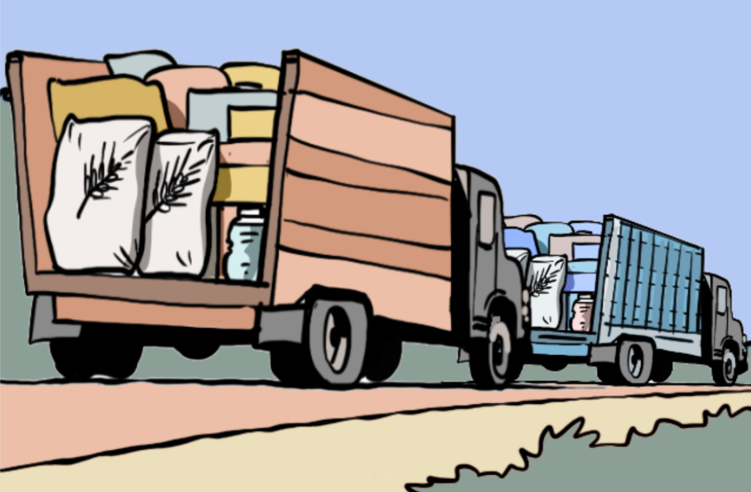

Humanitarian assistance policy
Armed actors have the primary responsibility for ensuring adequate supplies of food to populations under their control.
Armed actors must facilitate the delivery of principled humanitarian assistance.
Armed actors must put in place policies prohibiting diversion and looting of humanitarian commodities, attacking aid workers, facilities and supplies, and arbitrarily denying humanitarian access
13
Notes:
​Notes:
Explain that armed actors have the primary responsibility for ensuring that the basic needs, including adequate supplies of food and water, of populations under their control are met. ​
Ask participants how they think that this could be done and what would be needed to do so. ​
Listen to their inputs and explain that:​
- Armed actors should recognize the critical role that humanitarian actors play in supporting civilian’s food security. They should facilitate the delivery of principled humanitarian assistance to all affected populations. ​
- Armed actors must also put in place and enforce policies that prohibit: ​
a. diversion and looting of humanitarian commodities, including agricultural inputs, food commodities and ready-to-use therapeutic food​
b. threatening or attacking aid workers, operations, facilities or supplies and ​
c. arbitrarily denying consent for humanitarian organizations to access civilians in need of humanitarian assistance.​

Slide 14

Exercise: humanitarian assistance policy
  What actions does the policy provide to ensure that civilians' needs, including food security, are met?​
  How does it address the delivery of humanitarian assistance?​
  In which ways could it be improved to further meet civilians' needs?
14
Notes:
Notes:
Exercise 6 (in groups) (20 minutes): ​
Note: for non-State armed groups you can use for example the KNU policy for humanitarian assistance available at http://theirwords.org/media/transfer/doc/knu_s_policy_for_humanitarian_assistance_2014-be64212cf1a6b6dffd134dee3e7e6a25.pdf​
For state forces you might want to use this example of agreement between Sudan and South Sudan to allow the cross-border transport of humanitarian assistance https://ihl-in-action.icrc.org/case-study/south-sudan-humanitarian-relief-and-assistance​
For civil society actors you can chose to also do this exercise, as it may serve them in future advocacy work.​
Divide participants into groups of 3-5. Provide each of them with a different example/extract of an (anonymous) policy. ​
Ask them to study the example and: ​
- assess what actions the policy provides to ensure civilians' needs, including food security​
- assess how it addresses or operationalizes the delivery of humanitarian assistance​
- list gaps and ways in which it could be improved​
Alternative exercise:​
Work in plenary and ask participants​: What humanitarian assistance policies armed actors in the region have in place (themselves or other armed actors) ​
Then assess with them according to the same questions.​
As before, the last aspect of this exercise is particularly important, whether they are discussing their own policies or someone else’s. ​
Make sure to properly list all possible new or improved practices the actor would consider adopted. In case, these practices and issues could be present during the closing session (for reflection and strategizing) and could then be ranked according to the needs and the feasibility or the measures.​
​
​
​

Slide 15

Personnel: Resourcing and training
Armed actors should take all feasible steps to ensure that civilian-harm mitigation policies are well understood, implemented, and enforced.
15
Notes:
Notes:
Personnel: Resourcing and training​
Explain that it is necessary that armed actors take all feasible steps to ensure that civilian-harm mitigation policies are well understood, implemented, and enforced amongst their personnel. ​
Ask them how they think that this could be done and what would be needed to do so.​
Listen to their inputs and explains that armed actors should dedicate financial and human resources to ​
training staff, ​
developing operational policies, and ​
implementing civilian-harm mitigation and response efforts. ​
Every effort should be made to ensure that staff, according to their function, have full knowledge of their legal obligations, including but not limited to IHL, and are trained according to policies and procedures for minimizing and preventing civilian harm. This can be realized gradually through progressive training.​
Additionally, staff could build capacity and expertise on ​anticipating how military operations and behavior of personnel might impact civilians in different environments and among different vulnerable communities, specifically in relation to food security. That will increase their ability to plan contingencies to avoid such an impact. Foreseeing such an impact will require building capacity to collect, track, and analyze the necessary information on civilian harm. ​
​
​

Slide 16



1.How does trainings work within the organization?​
2. What types of trainings specifically on preventing and mitigating food insecurity would be needed:​
​
On what ?
For whom ?
Identifying training needs
16
Notes:
Notes:
Exercise 7 Identifying training needs: (10 minutes in plenary)​
Note: For civil society you can skip this exercise here and leave the discussion for the closing reflection, as it may serve them in future training work with armed actors.​
​Ask them ​if they can explain how training is done within their organization (at what point in the recruitment, how often, for whom, on what topics)​
Ask them what different types of trainings would be needed to improve the implementation of policies on food security?​
Ask them who would need to receive which trainings. For example:​
On existing or new policy: all staff?​
On anticipating how military operations and behavior of personnel might impact civilians: planning staff? (red-teaming staff: NATO: A red team is a team formed with the aim of rigorously analyzing the plans, programmes, ideas and assumptions that lead to a commander's decision.)​
Ask them what detailed content would need to be included if they had to design a training to collect, track, and analyze the necessary information on civilian harm​. For example on:​
The interconnectedness of critical infrastructure and essential services in urban environments and how conflict, specifically the use of explosive weapons, impacts civilian harm and food security in this environment.​
The causes of displacement and migration and the effect of these on various populations, including displaced and host communities. Particular attention could be placed on understanding the protection risks these communities may face and which segments of the population are most vulnerable to them.​
The humanitarian system, mechanisms, and components and how they work in coordination with armed actors and authorities to respond to humanitarian needs.​
Background:​
Sources: ​
ICRC, International Humanitarian Law Database, Rule 142.​
ICRC (2021), Urban warfare: an age-old problem in need of new solutions; and ICRC (2023), How can fighters reduce civilian harm in urban warfare?​
ICRC (2022), Explosive weapons: Civilians in populated areas must be protected.​
​

Slide 17
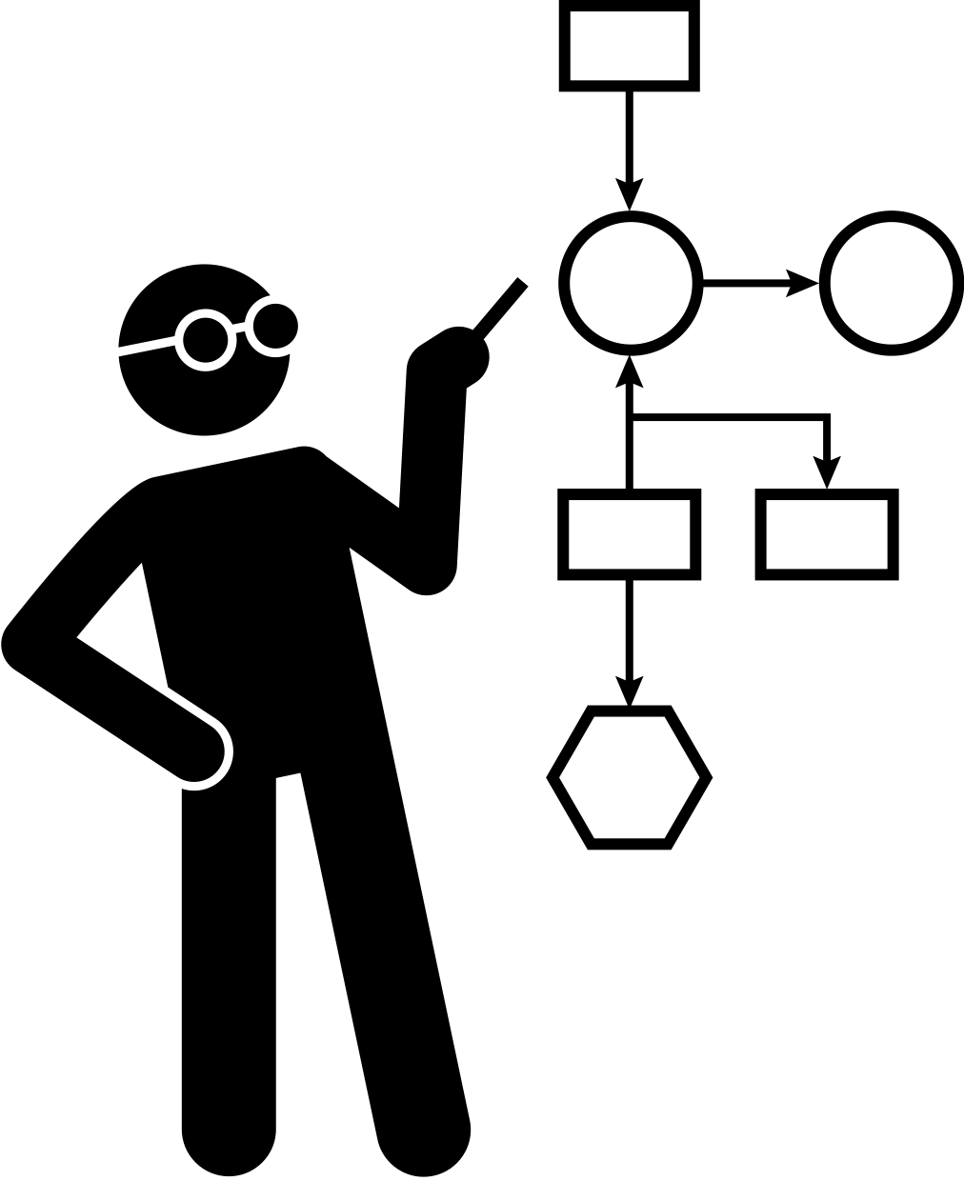
Frameworks for Monitoring, Learning and Applying Lessons Learned
On conflict-induced food insecurity
17
Notes:
Notes:
Frameworks for monitoring, learning, and applying lessons learned​
Explain that obviously things are not expected to work perfectly or very smoothly directly, but some learning and adaptation should be expected.
Armed actors can only prevent and mitigate civilian harm, including conflict-induced food insecurity, when they understand the effects of their actions in the short- and long-term on the health and safety of civilians and what needs to be improved. This requires them to collect and analyze information and apply lessons learned. ​
Explain that, for this reason, it is important to have in place a framework for monitoring policies and operational practice on preventing and mitigating conflict-inducted food insecurity, and for learning and adapting such lessons.​
​

Slide 18

Good practice on monitoring, learning and applying lessons learned
Develop/adapt civilian-harm-tracking mechanisms
Undertake post-battle civilian-harm assessments
Conduct lessons learned processes
Incorporate lessons learned into training exercises + revising policies and procedures
Provide transparency around civilian-harm assessments and investigations
Undertake regular monitoring of the impact on marginalized and disempowered groups
Participate in peer exchanges and build communities of practice
18
Notes:
Notes:
Explain that the Practical Measures document provides some good practices on monitoring, learning and applying lessons learned. ​
Explain that this is not exhaustive but could give some ideas for what might work for them.​
For example, armed actors should:​
Develop or adapt civilian-harm-tracking mechanisms to support the collection and analysis of civilian-harm incidents related to food insecurity and caused by armed actors’ presence and operations. These mechanisms should also collect and analyze the gendered dimensions of civilian harm and conflict-induced food insecurity.​
After every confrontation and operation, undertake post-battle civilian-harm assessments with an emphasis on understanding any direct and indirect impact on food security, including how different groups of civilians will experience this harm. This should include incorporating external information, such as civil society documentation, survivor and witness interviews, and site visits.​
Conduct lessons learned processes to improve operational planning and systematize good practices on avoiding, minimizing, and mitigating the effects of operations on food security.​
Incorporate lessons learned into training exercises and revising policies and procedures as necessary.​
Provide transparency around civilian-harm assessments and investigations, and close feedback loops with civil society and survivors.​
Undertake regular monitoring of the impact of policies and practice on marginalized and disempowered groups, particularly women and girls and people with disabilities.​
Participate in peer exchanges and build communities of practice at national, regional, and international levels, to share good practices and monitor implementation of the Practical Measures.

Slide 19
  What are the existing frameworks that you have in place? ​
​
  Can you give an example of when the framework has been used or a lesson learned that you have collected?​
​
  How could the framework be improved?​
​
Frameworks for monitoring, learning and applying lessons learned​
19
Notes:
Notes:
​
Exercise 8 Existing Frameworks for monitoring, learning and applying lessons learned: (10 minutes in plenary)​
Note: For civil society you can skip this exercise here and instead do a modified version of the exercise in the final module (see exercise 16.F). ​
Note: It’s not ideal to do this exercise after the explanation/presentation of the good practices, but rather before. Nevertheless, if conducted too close after the discussion on the training needs, participants risk being tired and not very participatory. Also, monitoring, learning and applying lessons learned risks being one of the areas they may know less about, so the presentation of the good practice might help them to have some ideas for the discussion and what could be done.​
Ask them:​
how monitoring, learning, and applying lessons learned is done within their organization and what framework/tools/processes do they have in place? ​
if they can give an example of one moment when the framework was used?​
(if you have the time and they seem open) if they have any ideas how this framework could be improved?​
​

Slide 20

Module wrap-up & conclusions
20
Notes:
Notes:
​
Check-Out Session and Closing of Day 1​
Required: an object to pass around amongst participants​
Activity: Check-Out Circle:​
you can ask participants to sit in a ring and pass an object around to each other ​
each says one thing that they leant or would like to particularly stress from the day ​
Make sure that everyone gets to speak and that all inputs are respected. ​
Close the day by thanking the participants. ​
Remind them what time they are expected in the training the following day.

Slide 21
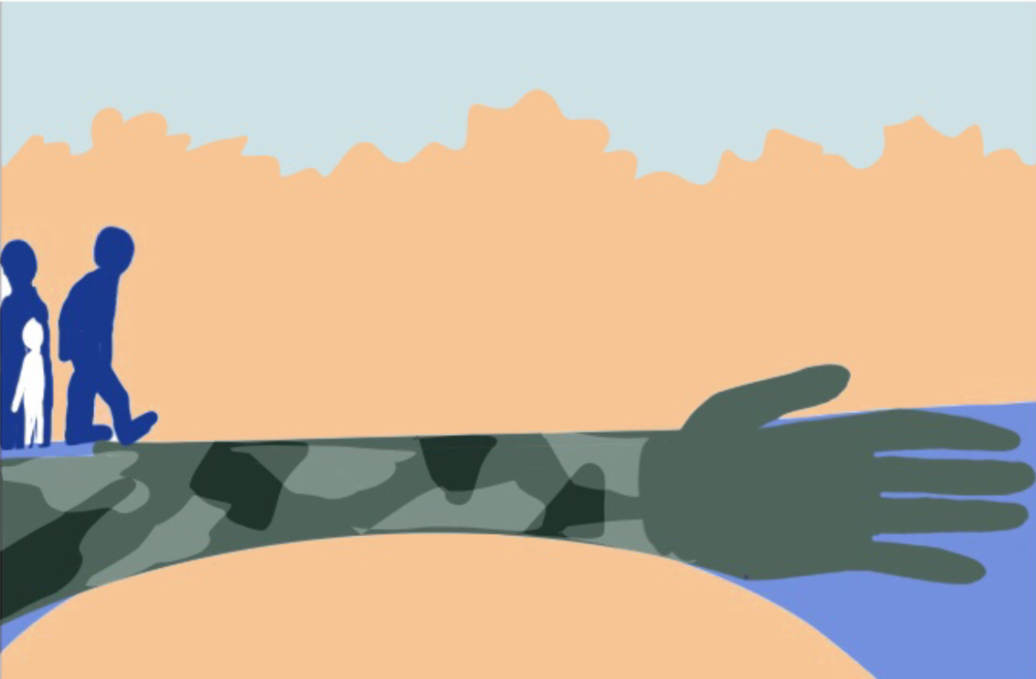
Questions ?
Notes:
Notes:
Address any questions or concerns raised by the participants.

