Slide 1

Training on the Practical Measures for Armed Actors to Prevent and Mitigate Conflict-Induced Food Insecurity
Module 1
Conflict-Induced Food Insecurity
Notes:
Notes:
Introduction and Module 1, Conflict-Induced Food Insecurity
*Please note that the cover page should vary depending on the content of the training. Remember to change the title accordingly when you prepare the training.
​

Slide 2

Introduction
02
Notes:
Notes:
For introduction session:
Time needed: 45 minutes
Set-up: circle set up in the beginning, if possible, tables for pre-test at the end of the session (if done).
Material: agendas for all participants, flip chart or similar available for note-taking, pre-tests and pencils for all participants
Purpose: To make participants feel comfortable and to make sure they have understood the objectives of the training.

Slide 3


Welcome and presentations
03
Notes:
Notes:
Depending on the size of the group and the time available, allow for participants to introduce themselves briefly, possibly through an icebreaker exercise.
Welcome, presentations, and icebreaker:
The co-organizer or responsible commander welcomes the participants. Then you as facilitator(s) welcome participants to the training, introduce yourselves and explain your role in the training. Talk about your backgrounds and experience and what led you to the topic.
Explain that you are looking forward to getting to know all of them and finding out more about their experiences and expectations and explain that you will then go over the training objectives and some logistics together, followed by some house rules.
Ice breaker activity (10 minutes): Use the ice breaker activity below, alternatively from Annex 2.E or create your own.
Example ice-breaking discussion on participants’ expectations
Ask the participants about their main needs and expectations linked to the topic, if there are any questions that they hope to find answers to, tools, guidance etc. These can be general or specific: it can go from “I would like to improve my knowledge of hunger in today’s conflicts” to very specific questions such as “At the checkpoints, we sometimes make farmers wait for a long time with their produce, is this allowed? We need to search their good and this takes time.”
Do not answer the questions now but write them down and keep them so that you can come back to them and debrief at the end of the training. Take notes of all expectations that represent different needs and ideas.
Insist on the fact that all questions are relevant and highly encouraged.

Slide 4

Objective 1
Participants have a better understanding of why it is important to prevent and mitigate conflict-induced food insecurity and how this could be done in their specific context, notably through the Practical Measures tool.
Training objectives
Objective 2
Participants have a better understanding of the content of the Practical Measures and how they can implement them in practice to prevent and mitigate conflict-induced food insecurity.
04
Notes:
Notes:
Training objectives:
Explain that the objective of this training (for all trainings) is that participants have a better understanding of why it is important to prevent and mitigate conflict-induced food insecurity and how this could be done in their specific contexts, notably through the Practical Measures tool.
For comprehensive trainings for armed actors only, there is a second objective, which is that participants have a better understanding of the content of the Practical Measures and how they can implement them in practice to prevent and mitigate conflict-induced food insecurity.

Slide 5
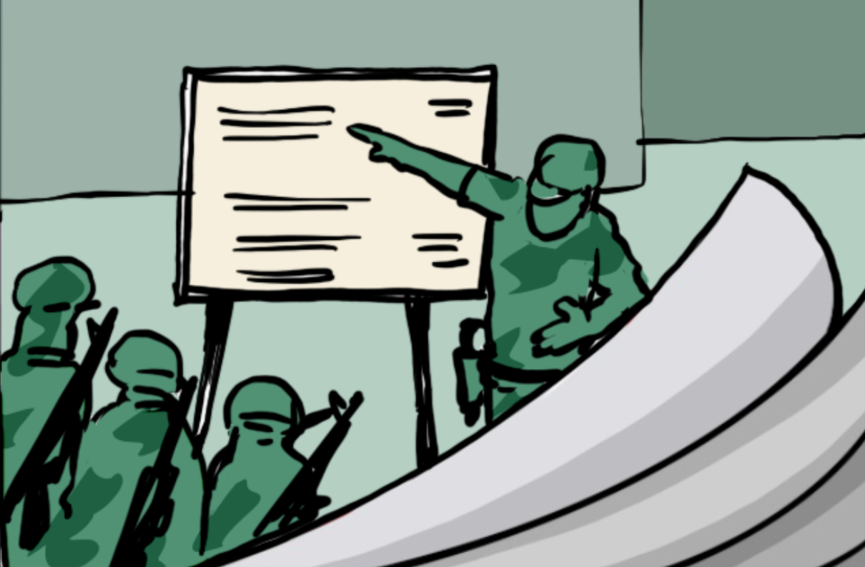

Rationale
Armed conflict ​
Food crises​
Destruction of livelihood, markets, livestock, means of food production​
Contamination of agricultural land and water supplies ​
Disruption of humanitarian aid​
Situation of critical food insecurity for millions of people
05
Notes:
Notes:
Explain that armed conflict is currently the main driver of the world’s food crises and therefore it is important to address this issue. Armed conflict can cause the destruction of livelihood, markets, livestock, means of food production, contamination of agricultural land and water supplies and the disruption of humanitarian aid, leading to a situation of critical food insecurity for millions of people.
Ask them how this might happen. Explain that:
- Crops, agricultural land, or critical infrastructure are damaged or destroyed by fighting.
- The closure of trade routes and collapse of local markets due to insecurity can also be damaging.
- Hunger can cause direct negative impact on the civilian populations’ health, causing illness, malnutrition or disabilities, but it can also lead to displacement and a number of human right violation (sexual exploitation, child labor, etc. etc.).
In this context armed actors have a legal obligation to protect civilians from hunger and take concrete measures to mitigate the consequences of armed operations on food security. They can take a number of measures, such as:
- not targeting food production, processing, storage, transport and distribution sites.
- not contaminating food and water sources with mines, biological or chemical weapons.
- facilitating civilians’ safe access to food and water, including humanitarian aid.
- not using strategies such as blockades that aim at starving the population.
In addition, they can take additional measures, such as:
- avoid conducting offensives at sensitive times, such as harvesting or market times and locations or distribution routes.
- avoid conscripting farmers, fishers, and others engaged in food production and distribution.
- provide military units with sufficient food so that they do not appropriate civilian property.
Explain that:
- all these measures could be integrated in the armed actors’ policies, training and accountability systems, for the survival and protection of the civilian population.
- this training will make it possible for actors to be better aware of some measures so that they can either take such measures directly or encourage others to take such measures.
For civil society actors you can add:
- In many context it is not “the conflict” as such as a generic problem, but it is the behavior of armed actors that directly leads to conflict- induced food insecurity.
- This means that to stop the food crises, armed actors must change their behavior.
- Conflict-induced food insecurity is foreseeable and largely preventable. It is the responsibility of armed actors, whether State armed forces or non-State armed groups, to prevent and mitigate conflict-induced food insecurity.
- Such efforts will complement efforts undertaken in the political and advocacy level.
- For sure, it will be difficult to change the behavior of parties to armed conflict that on purpose, as a strategy, are violating International Humanitarian Law (IHL). However, we can work towards changing the behavior of armed actors who are not doing this as a policy, but because they are not aware (of the rules or the impact of their behavior or both) or have not taken proper preventive measures. This goes for IHL violations, but also very much so for preventing and mitigating conflict-induced food insecurity.
- Ask them how they think we can help armed actors change their behavior? By educating them on the impact their actions have on food insecurity, and by providing alternative concrete steps they can take to change their behavior. This is what the Practical Measures are about!

Slide 6

Agenda & housekeeping
06
Notes:
Notes:
Make sure they all have a physical copy of it in their welcome kit (if used) and show it the following one or two slides, depending on your training design.
Logistics: explain how long the session are, when there are breaks, for how long, the location of the bathrooms, and where and when refreshments and food will be served.
House rules: house rules are important to establish expectations for participants. It is best if these expectations are decided upon collectively. At a minimum, this could be:
- Everyone has a wealth of experience, so we kindly ask all participants to engage in the training.
- Raise hand when you want to speak and wait to be called on.
- Be respectful, do not speak out of turn.
- Respect others’ opinions and perspectives.
- Phones should be set to silent mode.
+ any other rules that the participants would like to add.

Slide 7
Agenda: Day 1 armed actor training
Time | Session
45 minutes | Introduction Session
60 minutes | Session 1: Module 1 Conflict-Induced Food Insecurity
15 minutes | BREAK
40 minutes | Session 2: Module 2 Introduction to the Practical Measures
60 minutes | Session 3: Module 2 (cont.) Legal and Normative Framework of the Practical Measures
60 minutes | LUNCH AND ENERGIZER
40 minutes | Session 4: Module 2 (cont.) Content and Purpose of the Practical Measures
60 minutes | Session 5: Module 3 Civilian-Harm Mitigation Policies
15 minutes | BREAK
35 minutes | Session 6: Module 3 (cont.) Humanitarian Assistance Policy
45 minutes | Session 7: Module 3 (cont.) Personnel: Resourcing, and Training & Monitoring, Learning, & Applying Lessons Learned
15 minutes | Check-Out Session and Closing of Day 1
07
Notes:
Notes:
DELETE THIS SLIDE FOR CIVIL SOCIETY TRAININGS
Note: The slide shows the proposed outline of day 1 for the training for armed actors. This would need to be modified at least by removing the duration and adding the exact start and end time of each session (as this may vary).
Provide a brief overview of the agenda.
Make sure they all have a physical copy of the agenda in their welcome kit (if used).

Slide 8
Agenda: Day 2 armed actor training
Time | Session
15 minutes | Check-in Session
50 minutes | Session 8: Module 4 ​ Considerations for Planning and Conducting Operations
40 minutes | Session 9: Module 4 (cont.) ​ Access to Food and Water, Including Humanitarian Assistance and Services
15 minutes | BREAK
45 (-65) minutes | Session 10: Module 5 ​ Partners and Allies
30 minutes | Session 11: Module 6 ​ Increasing Food Security
60 minutes | LUNCH AND ENERGIZER
45 minutes | Session 12: Module 6 (cont.) ​ Ensuring Accountability
60 minutes | Session 13: Module 7 ​ Recap and Reflections
15 minutes | BREAK
30 minutes | Cont. Session 13: Module 7 Exercise on Operationalizing the Practical Measures
35 minutes | Check-Out Session and Closing of Training
08
Notes:
Notes:
DELETE SLIDE FOR CIVIL SOCIETY TRAININGS
Note: As mentioned in the previous slide, modifications would be needed to this slide fit your exact training.
Make sure to go through this one quickly, it will mainly be used during day 2.

Slide 9
Agenda 1-day training
Time | Session
45 minutes | Introduction Session
60 minutes | Session 1: Module 1 Conflict-Induced Food Insecurity
15 minutes | BREAK
40 minutes | Session 2: Module 2 Introduction to the Practical Measures
45 minutes | Session 3: Module 2 (cont.) Legal and Normative Framework of the Practical Measures
20 minutes | Session 4: Module 2 (cont.) Content and Purpose of the Practical Measures
60 minutes | LUNCH AND ENERGIZER
35 minutes | Session 5: Module 3 Civilian-Harm Mitigation Policies
30 minutes | Session 6: Module 3 (cont.) Humanitarian Assistance Policy
30 minutes | Session 7: Module 3 (cont.) Personnel: Resourcing, and Training & Monitoring, Learning, & Applying Lessons Learned
15 minutes | BREAK
90 minutes | Session 8: Module 7 Recap, Reflections and Exercise on Operationalizing the Practical Measures
35 minutes | Check-Out Session and Closing of Training
09
Notes:
DELETE SLIDE FOR ARMED ACTOR TRAININGS

Slide 10
Modules overview
1 Conflict-Induced Food Security
2 The Practical Measures
3 Preparation: Framework for Civilian Harm Mitigation
4 Operations: Measures to Prevent Conflict-Induced Food Insecurity in Operational Contexts
5 Cooperation: Partners and Allies
6 Responses: Addressing Harm Caused
7 Bringing it Together: Reflections and Closing
10
Notes:
Notes:
Present the modules that will be covered. Remember to adopt this to your actual training design:
Conflict-Induced Food Security
The Practical Measures
Preparations: Framework for Civilian Harm Mitigation
Operations: Measures to Prevent Conflict-Induced Food Insecurity in Operational Contexts
Cooperation: Partners and Allies
Responses: Addressing Harm Caused
Bringing It Together: Reflections and Closing

Slide 11

Training approach
11
Notes:
Notes:
Approach: Explain that the approach that we would like to see in these trainings is participative and interactive
Insist on the fact that all questions are relevant, and participation is highly encouraged, either because they can confirm what they already know or because they can acquire or improve knowledge on something they do not know.
During the training, ranks should be put aside – to the extent possible, and no one is here to be evaluated. The group will come out of the training stronger.
The training is built on the idea of exchange, teamwork and collective growth, to help us work for a better respect of the rights by everyone.
Pre-test:
If you use the pre-tests, distribute them and allow participants 5-7 minutes to complete them.
Explain that the purpose is not to evaluate them as individuals, but it’s to understand the learning/knowledge level of the group as a whole.
Address any questions or concerns raised by the participants.

Slide 12
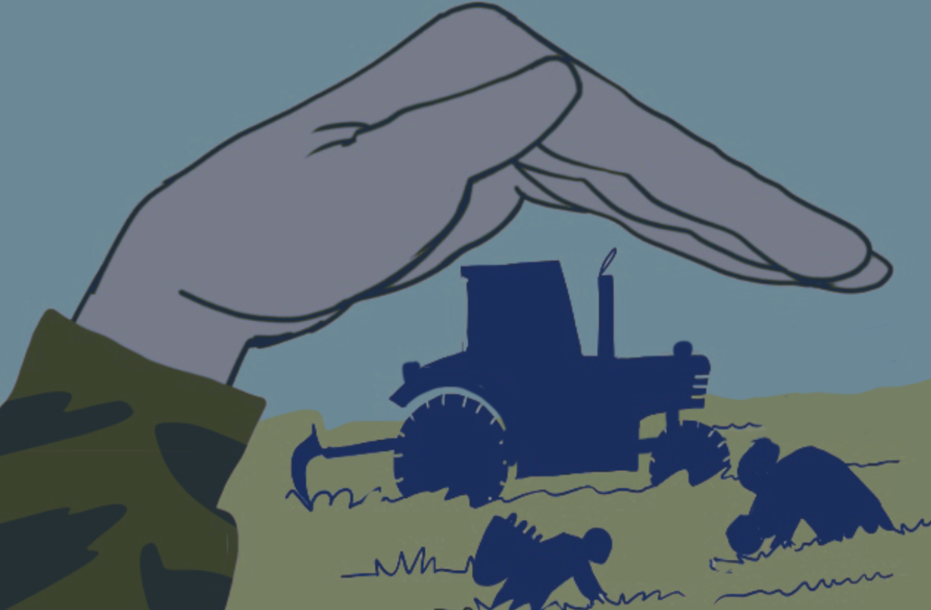
Module 1 ​
Conflict-Induced Food Insecurity
12
Notes:
Notes:
Module 1 Conflict-Induced Food Insecurity:
Time needed: 60 minutes
Set-up : free set up, space for group work (small groups or pairs)
Material: flip chart or similar available for note-taking especially for plenary mapping exercise.

Slide 13
Learning objective module 1
Participants are aware of the link between conflict and food insecurity, understand the various causes and impacts of food insecurity in conflict situations, and are able to relate this to their own context.
13
Notes:
Notes:
Learning objective:
Explain that the objective of this module is that is that participants are aware of the link between conflict and food insecurity, understand the various causes and impacts of food insecurity in conflict situations, and are able to relate this to their own context.

Slide 14



What causes food insecurity in your context? ​
Mapping the food insecurity landscape
14
Notes:
Notes:
Exercise 1.A (plenary discussion): Mapping the food insecurity landscape in the target context: mapping/notetaking on the white board/flip chart by the facilitators.
Time needed: about 15 minutes
Ask them what causes food insecurity in their context/what the main drivers of food insecurity are in their particular context? Alternatively: ask them what they know about food insecurity in their context?
Don’t go too much into detail on their responses, write down simple bullet points. Make sure to keep the sheets/list up for later reference.
Ask them if these drivers of food insecurity link to armed conflict? If yes, how? Alternatively, do only the first question here, and go back to the link to the armed conflict at a later stage once you have advanced in the explanations.

Slide 15

Key concepts & definitions
15
Notes:
Notes:
Say that before you really get started, let’s make sure we all understand some key concepts.

Slide 16

Hunger and food security – what do we mean?
16
Notes:
Notes:
Ask them: who can tell me how do you define HUNGER? And how can we understand FOOD SECURITY and FOOD INSECURITY?
Listen to the answers, if there are mistakes make sure you rectify them by saying what is correct and what it is NOT correct. Show the next slide.

Slide 17


Hunger & food security
Hunger: ​
“An uncomfortable or painful physical sensation caused by insufficient consumption of dietary energy. It becomes chronic when the person does not consume a sufficient amount of calories (dietary energy) on a regular basis to lead a normal, active and healthy life.”​
FAO
Food security: ​
“When all people, at all times, have physical, social and economic access to sufficient, safe, and nutritious food that meets their dietary needs and food preferences for an active and healthy life.” ​
Practical Measures document ​
17
Notes:
Notes:
Read out the definitions:
Hunger: “An uncomfortable or painful physical sensation caused by insufficient consumption of dietary energy. It becomes chronic when the person does not consume a sufficient amount of calories (dietary energy) on a regular basis to lead a normal, active and healthy life.” (FAO)
Food security: "When all people, at all times, have physical, social and economic access to sufficient, safe, and nutritious food that meets their dietary needs and food preferences for an active and healthy life.” Explain that food security includes food availability, access to food, utilization of food, and stability of food security. (Practical Measures document)
Food insecurity is the absence/the opposite of food security.
Explain that the decision was not to use hunger in the Practical Measures document, because it is a more limited concept – more immediate and short-term. Food insecurity can lead to hunger, but it’s more than that.
Background:
Terms such as ‘food security’, ‘hunger’, ‘famine’ and ‘starvation’ are not defined in international treaties.
‘Starvation’ is used in the Additional Protocols to the Geneva Conventions without definition. The commentary on Article 54(1), AP I (p. 653, para. 2089) states that the term ‘starvation’ is “generally understood by everyone”, with the footnote: “Starvation is defined by the Shorter Oxford English Dictionary (1973) as the action of starving or subjecting to famine, i.e., to cause to perish of hunger; to deprive of or ‘keep scantily supplied with food’”. In the commentary on Article 14, AP II (p. 1456, para. 4791), starvation is described as “the action of subjecting people to famine, i.e. extreme and general scarcity of food”. ‘Starvation’ in these contexts includes deprivation of drinking water. See also the ICRC Study on Customary International Humanitarian Law, p. 193, commentary on customary Rule 54.

Slide 18
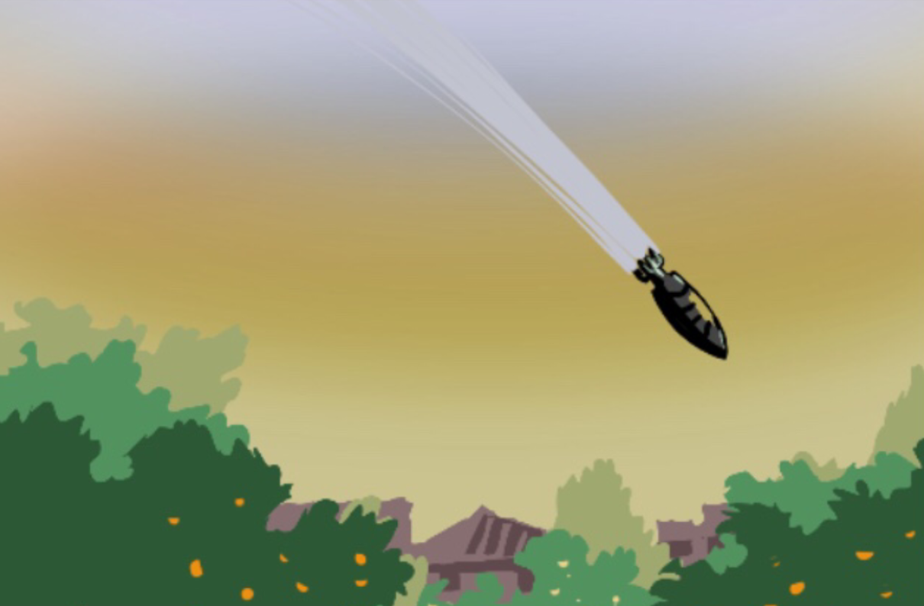
Civilian harm
"All negative effects on civilian personal or community well-being caused by the use of force in hostilities, as well as actions taken by soldiers or units outside of combat."​
​
Practical Measures document
18
Notes:
Notes:
Ask participants what their understanding is of civilian harm.
Explain that mitigating civilian harm is at the core of what this training is about, especially in relation to their food security.
Give the definition of civilian harm as : "All negative effects on civilian personal or community well-being caused by the use of force in hostilities, as well as actions taken by soldiers or units outside of combat.” (Practical Measures document)
Explain that the effects (the civilian harm) can occur:
- directly: through death, physical or mental trauma, property damage or
- indirectly: through the destruction of critical infrastructure, disruption of access to basic needs and services, or the loss of livelihood.

Slide 19
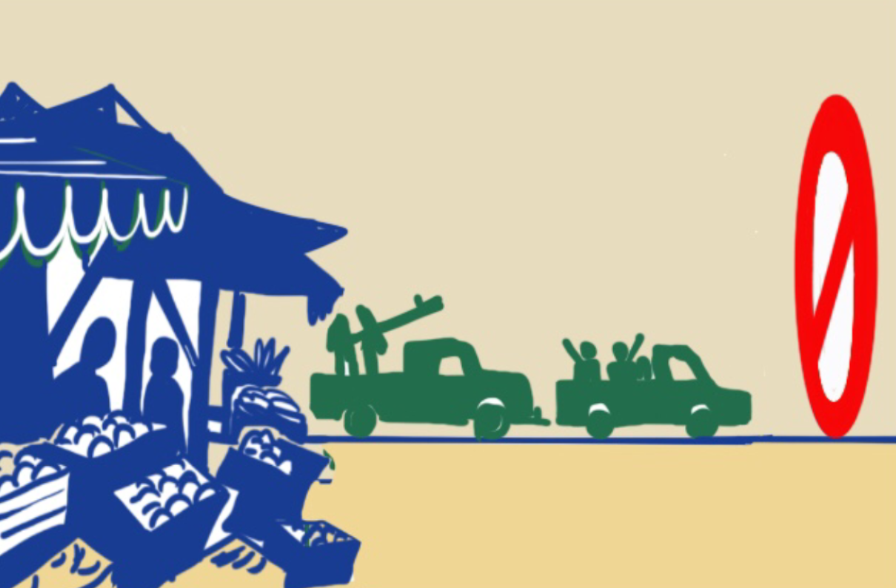
Armed actors
  State armed forces​
  Law enforcement entities​
  Non-State armed groups​
  Peacekeeping forces​
  Private military and security companies
19
Notes:
Notes:
Explain that armed actors can be at the core of the problem of food insecurity, but they can also be at the core or bringing solutions to this problem.
Say that it is good to make sure there is a common understanding of what we mean by armed actors. Armed actors can be for example:
- State armed forces: A country’s armed forces—i.e., their air force, army, navy, coast guard, etc.
- Law enforcement entities: State-affiliated entities that may or may not be military entities, such as border police, customs, and local police.
- Non-State armed groups: Organized armed groups that are not within the formal structures or under the overall control of a state. They include both opposition and pro-government groups, politically and economically motivated groups (such as gangs). Note that in addition to arms carriers, some armed groups may also have a political wing and/or a civilian administration, including a humanitarian relief branch.
- Peacekeeping forces: Civilian and military personnel placed by their national governments at the disposal the international organization under whose mandate the peacekeeping operation is being conducted.
- Private military and security companies: These are private companies that trade in security and/or military services, mostly outside their home states.
Explain that the training was prepared mainly with State armed forces, non-State armed groups, and de facto authorities, and the relevant civilian administrations and/or ministries related to these armed actors in mind. However, say that the training is also relevant for some law enforcement agencies, peacekeeping forces, and private military and security companies, depending on what kind of operations they are involved in. Ask who the main armed actors are in their context. And listen to and possibly take notes of their answers. Particularly for civil society trainings it is useful to have a good understanding of who the main actors are, as they may also become targets of advocacy and training efforts in the future.

Slide 20

A global perspective
Nearly 282 million people in 59 countries and territories experienced high levels of acute hunger in 2023
Food insecurity is largely due to how armed actors conduct themselves: destruction of people’s livelihoods, markets, crops, livestock, and other vital infrastructure; blockages, attacks on aid workers, mine contamination and forced displacement.
International law sets out various rules to ensure food security and prevent hunger in situations of armed conflict.
Despite this, the number of people affected by food insecurity continues to rise.
20
Notes:
Notes:
Explain that:
According to the latest Global Report on Food Crises (GRFC), nearly 282 million people in 59 countries and territories experienced high levels of acute hunger in 2023 - a worldwide increase of 24 million from the previous year. This rise was due to the report’s increased coverage of food crisis contexts as well as a sharp deterioration in food security, especially in the Gaza Strip and the Sudan.
Food insecurity is largely due to how armed actors conduct themselves during hostilities (as mentioned in the first session). The destruction of livelihoods, markets, crops, livestock, and other vital infrastructure —all result in an immediate increase in instances of food insecurity amongst civilian populations. Restriction of people’s movement and humanitarian access, mine contamination of land, food and water supplies as well as forced displacement also contribute to food insecurity.
International Humanitarian Law (IHL) sets out measures to mitigate the impact of armed conflict on civilians. It prohibits the use of starvation of civilians as a method of war, pillage and attacks of objects indispensable to the survival of the civilian populations such as agricultural areas, crops, livestock, water installations, etc. It also obliges parties to conflict to ensure adequate supplies of food and water and to allow rapid and unimpeded passage of humanitarian relief.
In 2018, the UN Security Council adopted Resolution 2417, which recognizes conflict-induced hunger as a threat to international peace and security. The resolution calls for parties to armed conflict to comply with their obligations under IHL regarding respecting and protecting civilians and taking constant care to spare civilian objects, including objects necessary for food production and distribution.
Despite this, the number of people affected by conflict-induced food insecurity continues to rise.

Slide 21
Linkages between armed conflict and food insecurity
1
2
3
Armed conflict is the main driver of food insecurity today​
In 2023, 135 million people in 20 countries were facing acute food insecurity due to conflict.
All countries with people facing famine conditions are in protracted conflict or violence.​
21
Notes:
Notes:
Explain that:
Armed conflict was the cause of acute food insecurity for almost 50% of those who suffered from it in 2023—affecting 135 million people across 20 countries—making it one of the primary drivers of hunger today. The Sudan faced the largest deterioration due to conflict, with 8.6 million more people facing high levels of acute food insecurity as compared with 2022.
The majority of countries experiencing armed conflicts and violence are also rural countries that are highly dependent on agriculture.
All countries with people experiencing famine conditions – Afghanistan, Burkina Faso, Haiti, Mali, Nigeria, Somalia and South Sudan - are affected by protracted armed conflict or violence.
Other key drivers of food crises:
In addition to armed conflict and violence, the impacts of economic shocks and the effects of extreme weather events continue to drive acute food insecurity. These interlinked drivers are exacerbating food systems fragility, rural marginalization, poor governance, and inequality, and lead to massive displacement of populations globally. The protection situation of displaced population is additionally impacted by food insecurity.
This does not mean that the drivers are always present at the same time, but when they are, the situation deteriorates significantly.
Economic shocks primarily affected 21 countries where around 75 million people were facing high levels of acute food insecurity, due to their high dependency on imported food and agricultural inputs, persisting macroeconomic challenges, including currency depreciation, high prices and high debt levels.
Extreme weather events were the primary drivers in 18 countries where over 77 million people faced high levels of acute food insecurity, up from 12 countries with 57 million people in 2022. In 2023, the world experienced its hottest year on record and climate related shocks impacted populations, with episodes of severe floods, storms, droughts, wildfires, and pest and disease outbreaks.

Slide 22
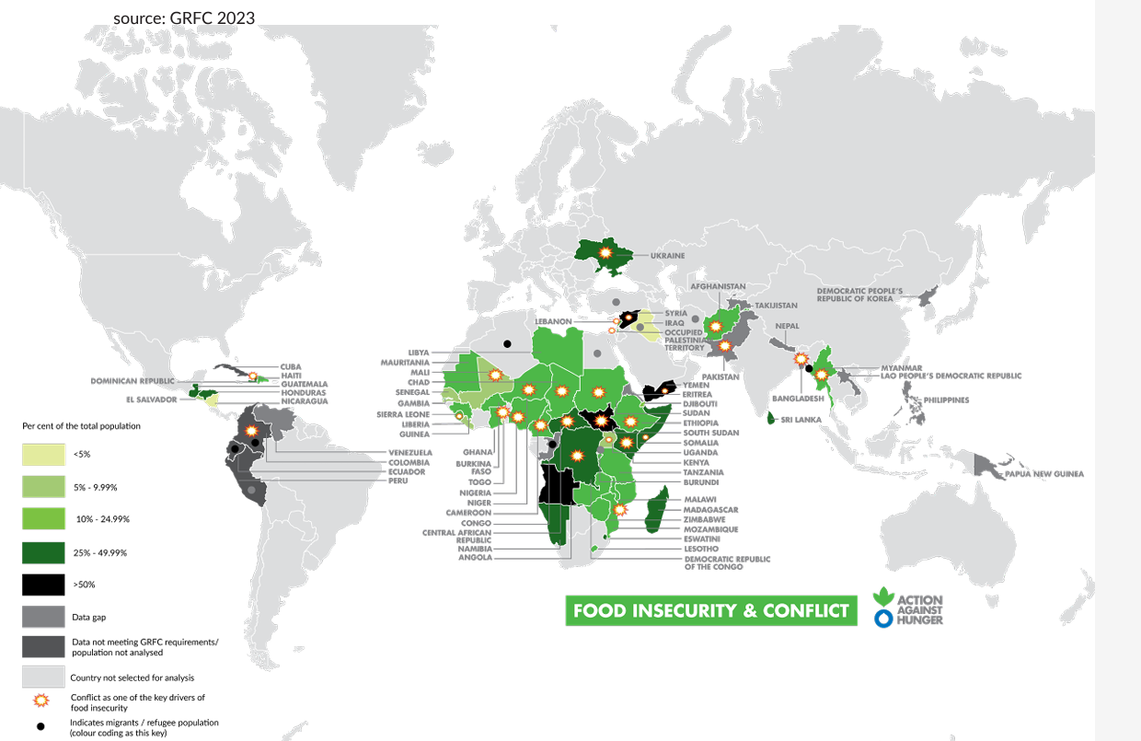
22
Notes:
Notes:
The map shows the countries most affected by armed conflict and food insecurity.
See Conflict-and-Hunger-report.pdf (actionagainsthunger.org)
Give them a moment to look at the map and maybe mainly look at their own region.

Slide 23
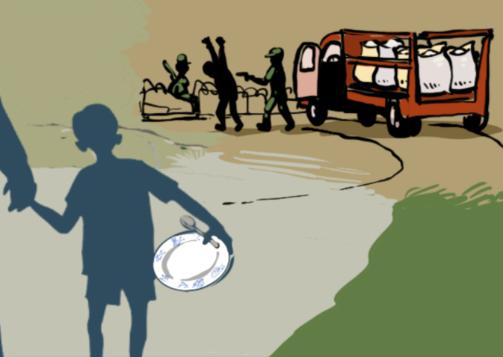


Mapping impacts of armed conflict on food insecurity
Direct and indirect impacts
Immediate, mid- and long-term impacts?
23
Notes:
Notes:
Exercise 1.B (optional) – add 20 minutes time if you do it (10 for group work, 10 for feedback and discussion)
Ask them to work in pairs or small groups to identify the direct and indirect impacts of armed conflict on hunger, but also what these consequences could be (for example, harm to food and water sources, disruption to food production and supply chains, access impediments to humanitarian aid, weapon contamination, destruction of basic services and infrastructure, forced displacement, increased vulnerability to protection risks, etc.)
Ask them to think about immediate, mid- and long-term impacts.
Reporting and discussion:
Have each pair/small group present two impacts, building on or completing what the other ones have said. Take notes.
Ask how they think that impacts may be affected by the levels of pre-existing food security/acuteness of the food insecurity.
Then pass on to the next slide of the explanation.

Slide 24
Direct Impact
Indirect Impact
  Damage and destruction of livelihoods, crops, livestock, markets, and critical civilian infrastructure
  Food shortages
Impacts of conflict on food insecurity
  Disruptions of food supply chains
  Restriction of people’s movements and access to food and humanitarian aid
  Displacement
  Increased vulnerability to protection risks
  Mine contamination of agricultural land and water sources
24
Notes:
Notes:
Explain that the way a conflict is fought can both directly and indirectly impact food security (as they might have explored in the previous exercise).
If they conducted exercise 1.B, make sure to make plenty of references to their findings when you present.
If they did not do exercise 1.B: Say: consider for a moment how the damage and destruction of livelihoods, crops, livestock, markets and critical civilian infrastructure (such as water facilities, power supplies, etc.) would lead to food shortages, and disruptions of supply chains. Now compound this by restricting people’s movements and access to food and humanitarian aid (through blockades of ports and roads, attack on aid workers, bureaucratic restrictions, etc.). Add contamination of agricultural land and water sources. The result is acute food insecurity, which often leads to displacement and creates other protection risks such as increased exposure to sexual exploitation and abuse, and child labor.
Explain the content of the slide, showing that there are both direct and indirect impacts.
You can show here the relevant excerpt (or the full video) from the Practical Measures video to illustrate the impacts.
Examples of impacts of armed conflict on food insecurity:
Attacks on food and water sources include the looting and destruction of crops, harvests and livestock. Such attacks reduces affect populations’ overall ability to generate food and income and often disproportionately impact the most vulnerable populations, such as children. Moreover, killing or kidnappings of civilians, including farmers or food producers, have been reported in many countries affected by conflict.
Attacks on infrastructure and public facilities that civilian populations rely on to their survival (such as water systems, power supplies, markets, etc.), disrupt the access to food and supply chains. The destruction of electricity grids leaves farmers unable to operate wells or pumps to irrigate lands for food production.
In many conflict-affected countries, the blockade of ports and roads lead to the disruption of commercial trade as well as the provision of humanitarian aid. This can drive severe hunger and malnutrition. Additionally, direct attacks on aid workers, bureaucratic and administrative restrictions, have impeded people's access to food.
Most countries experiencing the highest level of food insecurity and identified as hunger hotspots are among those who have reported mine contamination. Mines left behind render lands unusable, with farmers severed from working their lands until full decontamination has been conducted. Landmines are used to hinder access to agricultural lands, punish communities, and – in the case of those who have long been displaced – prevent their return.
Armed conflict and food insecurity can also provoke displacement and lead to other human rights abuses such as child labor and gender-based violence (notably sexual exploitation and abuse). These reverberating effects more often impact groups made vulnerable by conflict, such as women, children, older people, and persons with disabilities and chronic diseases.

Slide 25

Module wrap-up & conclusions
25
Notes:
Notes:
Ask one or several of the participants to mention the most important things they learned/noted in the module. Take note on the flipchart or white board. This is important to set the stage for the next modules.

Slide 26

Questions ?
Notes:
Notes:
Address any questions or concerns raised by the participants.

