Slide 1
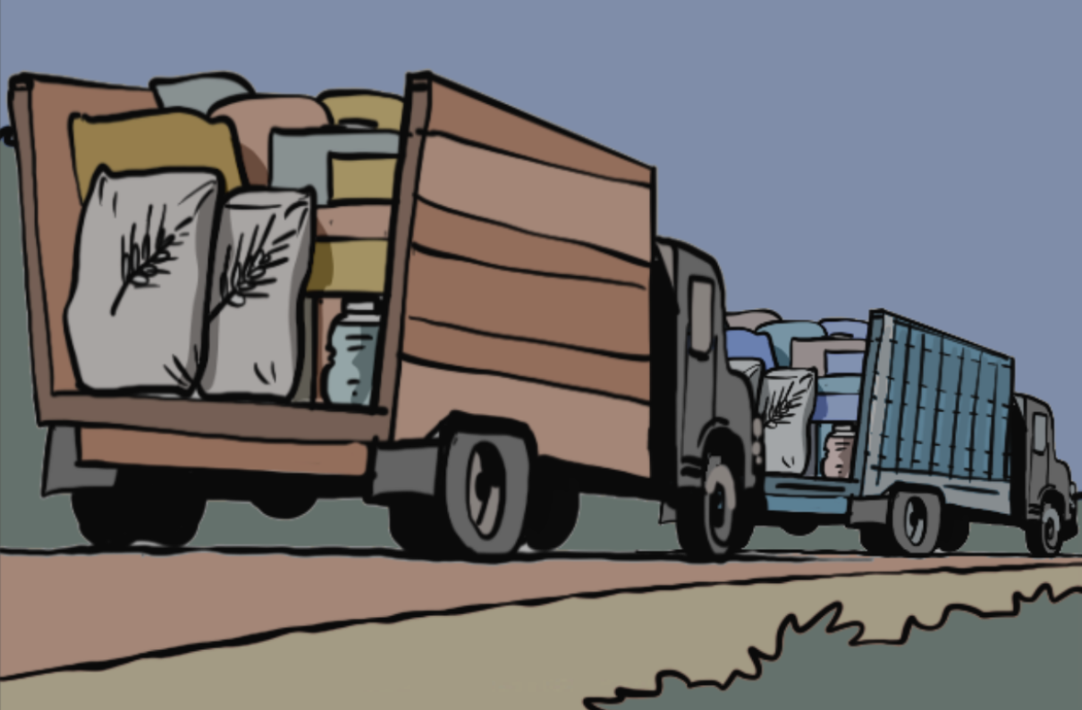
Training on the Practical Measures for Armed Actors to Prevent and Mitigate Conflict-Induced Food Insecurity
Module 4
Measures to Prevent Conflict-Induced Food Insecurity in Operational Contexts
Notes:
Notes:
Module 4, Mesures to Prevent Conflict-Inducted Food Insecurity in Operational Contexts.
Note: modules 3-6 are primarily designed for armed actors.​
Day 2 Check-In session (about 15 minutes):​
Start with welcoming the participants to the second day​
Present the agenda for the second day (see next slide) ​
If needed, choose an energizer exercise from Annex 2.D of the Facilitator’s Guide or invent your own​
Ask the participants if they have any questions or doubt remaining form the first day and clarify any open issues ​
Time needed: 90 minutes​
- Session 8: Considerations for planning and conducting operations: part 1: 50 minutes​
- Session 9: Considerations for planning and conducting operations: part 2 (access to food and water, including humanitarian assistance and services): 40 minutes​
Set-up: free set up, space for group work​
Material: flip chart or similar available for note-taking, big sheets of paper and markers for group exercises, print outs of the case study/studies for the participants​
​
​

Slide 2
Agenda: Day 2 armed actor training
Time | Session
15 minutes | Check-in Session
50 minutes | Session 8: Module 4 ​ Considerations for Planning and Conducting Operations
40 minutes | Session 9: Module 4 (cont.) ​ Access to Food and Water, Including Humanitarian Assistance and Services
15 minutes | BREAK
45 (-65) minutes | Session 10: Module 5 ​ Partners and Allies
30 minutes | Session 11: Module 6 ​ Increasing Food Security
60 minutes | LUNCH AND ENERGIZER
45 minutes | Session 12: Module 6 (cont.) ​ Ensuring Accountability
60 minutes | Session 13: Module 7 ​ Recap and Reflections
15 minutes | BREAK
30 minutes | Cont. Session 13: Module 7 Exercise on Operationalizing the Practical Measures
35 minutes | Check-out Session and Closing of Training
02
Notes:
Notes:
Note: The slide shows the proposed outline of day 2 for the training for armed actors. This would need to be modified as explain in module 1. ​
Agenda:​
You may or may not have showed them this slide already during day 2.​
Go through it and clarify questions as needed.
​

Slide 3

Learning objective module 4
Participants understand the main operational aspects of the Practical Measures and can relate this to their own contexts and organizations.
03
Notes:
Notes:
Learning objective: ​
Explain that the objective of this module is that is that participants understand the main operational aspects of the Practical Measures and can relate this to their own contexts and organizationz. ​

Slide 4



What do you need to consider when your forces conduct operations in order not to affect the food security of the population?
Assessing the food/water system as part of the civilian environment:
04
Notes:
Notes:
Exercise 9: Discussion (10 minutes discussion in plenary):​
Ask them what the civilian environment means to them and if they can give examples ​
Ask them how military operations may affect the civilian environment and specifically the food security of the civilian population ​
Ask them what they would need to consider (as armed actors) when planning and conducting operations in order not to affect the food security of the populations​
Listen to their answers and inputs and then move to the next slide.​
​
​

Slide 5

Key measures
05

Slide 6

Key measures
  Awareness of the civilian environment​
  Operational planning​
  Targeting​
  Protecting land and water​
  Conscription​
  Looting​
  Access to food, water, critical infrastructure and essential services​
  Humanitarian assistance and services
06
Notes:
Notes:
Explain that throughout operational planning and implementation, armed actors should actively consider their potential impact on civilians, civilian assets, and food insecurity. ​
Particularly, armed actors should avoid directly and indirectly causing or increasing food insecurity. ​
When planning and conducting operations, the IHL obligations of distinction, proportionality, and precautionary measures must be applied, including in the choice of weapons and means employed. ​
Obligations enshrined in IHRL must also be applied when appropriate.​
List the key measures that will be discussed in this module:​
Awareness of the civilian environment​
Operational planning​
Targeting​
Protecting land and water​
Conscription​
Looting​
Access to food, water, critical infrastructure and essential services​
Humanitarian assistance and services​
Explain that extra emphasis will be put on the last point, humanitarian assistance and services, given the crucial importance this has for conflict-affected civilians.​
​

Slide 7
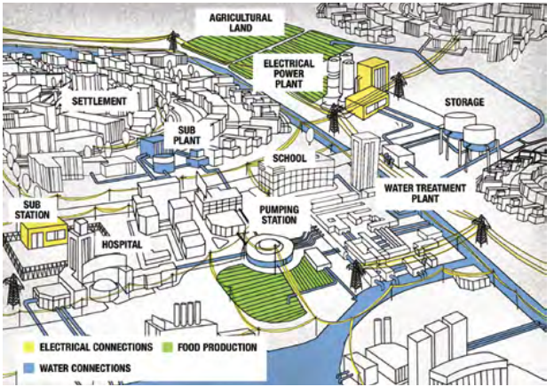
1) Awareness of the civilian environment
Armed actors should know the food and water systems to enable them to estimate the impact of their operations on the civilian population.
This includes for example: ​
  Crop planting and harvesting times​
  Market days and locations​
  Locations of food production, storage, and distribution sites
​
  Locations of regularly used food distribution routes​
  Location of humanitarian facilities
07
Credit: ICRC ICRC
Notes:
​Notes:
Explain that armed actors should know the food and water systems as part of the civilian environment to enable them to estimate the impact of their operations. ​
Ask participants how they think that this could be done and what would be needed to do so. ​
Listen to their inputs and explain that armed actors should be aware of the characteristics of the civilian population and the essential infrastructure, livelihood activities, organizations, personnel, resources, services, and systems on which civilians depend.
This includes assessing food and water systems as part of the civilian environment in which operations occur. This information will enable them to estimate the impact of their operations on civilian food and water security, and how that affects different population groups. It includes, but is not limited to, information on: ​
Crop planting and harvesting times​
Market days and locations​
Routes used for moving livestock​
Climate risks and lingering effects of previous climate shocks that impact food security and may be worsened by conflict ​
Availability of food and ready-to-use therapeutic food in a given context​
Locations of infrastructure necessary for food production​
Locations of food production, storage, processing and distribution sites, as well as clinics for emergency treatment of malnourished adults and children​
Locations of regularly used and emerging food distribution routes, via air, land and sea​
Locations of humanitarian facilities, sites and commonly used routes to facilitate passage and asset protection. The recording of these may be maximized by humanitarian notification systems, which are mechanisms that humanitarian actors use to inform parties to an armed conflict of the location of their facilities and movements.​
Regular dates and times of humanitarian and civil society food distributions, including during religious holidays.​
​Map credit: ICRC
​
​

Slide 8
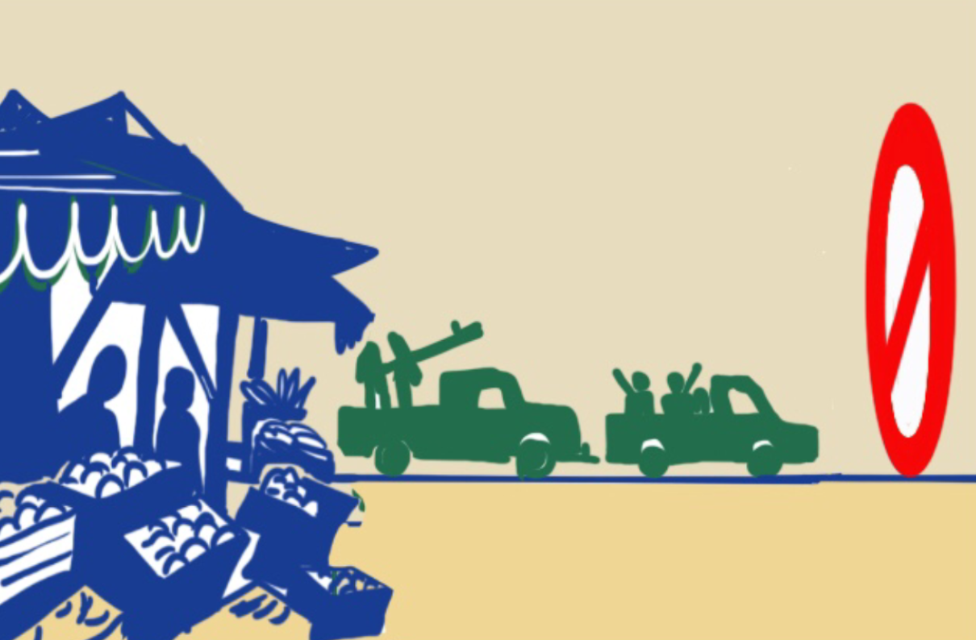
2) Operational planning​
Armed actors should prepare operational plans to minimize and respond to the foreseeable effects of their operations on food security. ​
​
​
This includes for example:​
  Timing and locations of offensives ​
  Choice of weapons​​
  Minimizing risks, especially to vulnerable groups​
  Coordination with local authorities to facilitate the safe movement of food and civilians' access to it
08
Notes:
​Notes:
Explain that armed actors should prepare operational plans to minimize and respond to the foreseeable effects of their activities on food security and water supplies, considering the principles of distinction, proportionality, and precautionary measures. These plans might consider:​
Timing and locations of offensives to avoid interfering with food production or distribution​
Choice of weapons such as landmines, explosive weapons, cluster munitions, and autonomous weapons, with a full understanding of the specific ways each weapon type impacts the production and distribution of food. Do not use, under any circumstances, anti-personnel landmines or biological and chemical weapons.​
Minimizing and avoiding safety, security and food access risks to all people—with a focus on (the specificities of) women and girls, men and boys, persons with disabilities, and other marginalized or socially excluded vulnerable groups.​
Working with local authorities and/or local communities to coordinate and facilitate the safe movement of food and civilians' access to it, including through facilitating humanitarian aid and for vulnerable communities in affected areas.​ (Note that non-State armed groups may be reluctant to coordinate with local authorities, as representative of the State they may be fighting, but in that case make sure to mention the possibility of coordinating at least with local communities.
​
​
​
​

Slide 9
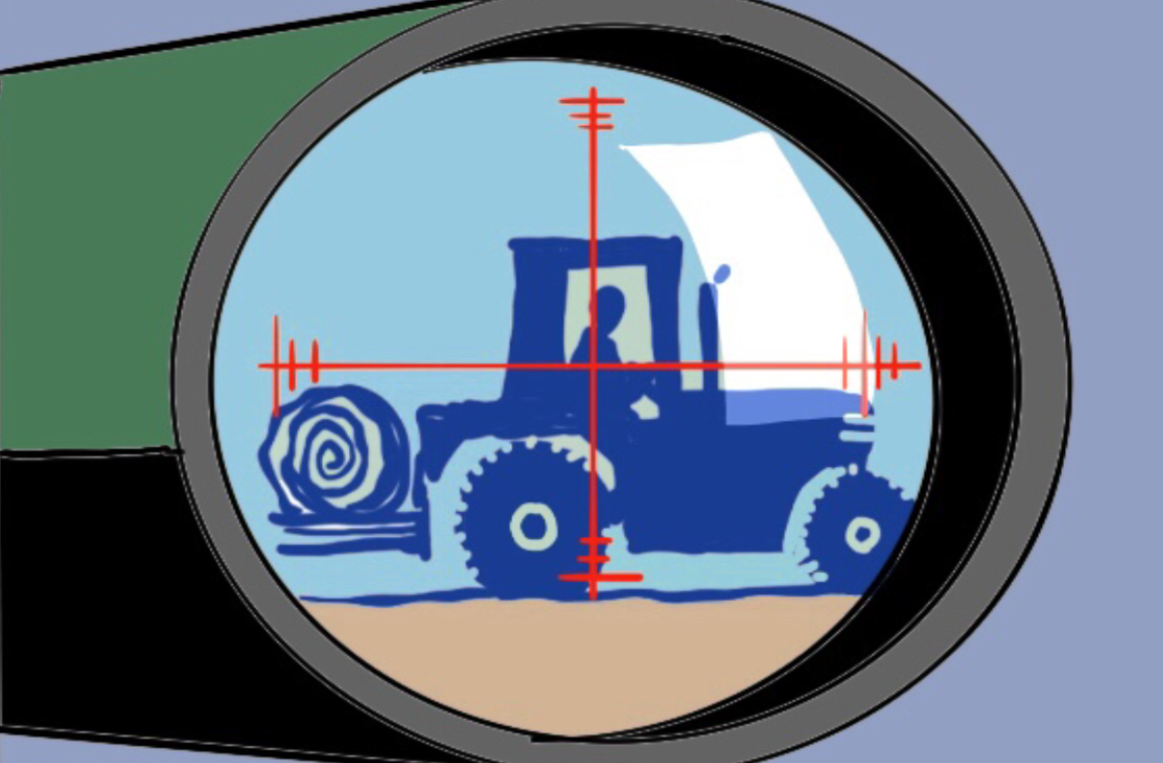
3) Targeting
Armed actors should not target civilians or civilian objects and avoid incidental damage to civilian objects, including critical infrastructure and essential services.
​
​
This includes for example:​
  Food processing and storage facilities (such as bakeries, mills and warehouses)
​
  Food transportation vehicles​
  Food sale sites (such as markets or stores)​
  Critical infrastructure (such as power plants and water systems)​
  Agricultural land and facilities ​
09
Notes:
​Notes:
Explain that armed actors should not target civilians or civilian objects and avoid incidental damage to civilian objects, including critical infrastructure and essential services. This includes, but is not limited to:​
Food processing facilities, such as bakeries, canning facilities, or mills.​
Food storage facilities, such as siloes or warehouses.​
Food transportation vehicles, such as ships, trains, and trucks.​
Food sale sites, such as markets or stores.​
Meal distribution facilities, such as religious sites and schools.​
Clinics for treating adults and children experiencing malnutrition.​
Other infrastructure required for food production, processing, and transport, such as ports, power plants, railway lines, roads, water systems, and water treatment centers.​
Agricultural and aquacultural facilities, and all physical instruments and constructions related to those activities, whether permanent or semi-permanent.​
Production and storage facilities for agricultural inputs, such as fertilizer, seeds, or tools​
Civilian real property (that is, agricultural or pastoral land).​
Remind them that many of the things in this list are specially protected under IHL, including objects indispensable to the survival of the civilian population. As such, attacks or other acts against those things may be prohibited or restricted even if they are being used for military purposes in ways that might otherwise render them subject to direct attack.
​

Slide 10

Exercise: ​
You are commanding a brigade, and your mission is to liberate the town of Eldetia. Your intelligence sources tell you that enemy forces occupy a food warehouse run by a humanitarian NGO inside the town. Many families depend on this NGO for their food security.​
There are at least ten armed elements. What's more, your intelligence reports that there may be heavy military equipment. ​
  Under international law, can you attack the warehouse? ​
  If you consider that the warehouse is a legitimate military objective, what would you take into account before ordering the attack?
  If you decide not to attack the warehouse, why not? Is there an alternative course of action? ​
10
Notes:
Notes:
Exercise 10: Scenario: (about 20 minutes)​
Divide participants into groups of 3-5. ​
Ask them to take 10 minutes to discuss the questions and agree on the answers.​
Ask each group to explain their answers and decisions and allow for debate.​
Suggested responses to the questions: ​
Yes, it is lawful under IHL to attack the warehouse as it is used for military purposes by enemy forces and thus has lost its protective status. ​
However, even if the attack is directed against a legitimate military objective, all feasible precautionary measures must be taken to avoid, and in any event to minimize, damage caused by its military operations to the warehouse and incidental death or injury to civilians potentially being inside or around. Such measures include a "proportionality assessment" between the military advantage anticipated and civilian harm caused, the timing of the attack, the choice of weapons, etc. ​
In addition, just because it is lawful to attack the warehouse doesn’t mean that it is a good idea to do so. Ask them to assess what could be the negative consequences for the civilian population in the area if the warehouse is attacked. For example, not just the concerned humanitarian organization may stop operations in the area, but perhaps other organizations as well, with dire consequences for the civilian population.​
If they decide not to attack, ask them what could be an alternative way of action instead of attacking the warehouse. For example, if there is no urgent need to conduct the attack, perhaps they could find a way of communicating with the humanitarian organization and explaining their concerns. Maybe they could gather additional intelligence to confirm/disconfirm that the warehouse is used for military purposes, and the possible role or not of the humanitarian agency. ​
​
​
​
​
​

Slide 11
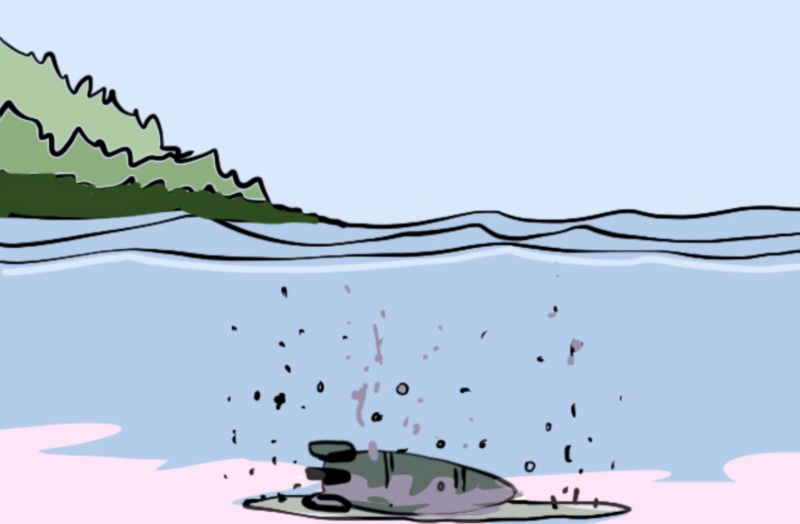
4) Protecting land and water
  Armed actors should avoid operations from or onto agricultural land, food storage facilities and other critical infrastructure​
  Armed actors should avoid contaminating food and water resources with explosive remnants of war, mines, or any biological or chemical weapons or substance.
11
Notes:
​Notes:
Ask participants how they think agricultural land and water resources could be best protected from the effects of military operations.​
Explain that armed actors should avoid:
staging operations from or onto agricultural land, food storage facilities, and other critical infrastructure for military purposes to avoid destruction by enemy fire.​
contaminating arable land, fisheries, hunting grounds, pastoral lands, food transportation routes, or water resources with explosive remnants of war, mines, or any biological or chemical substance that would kill animals, fish, or plants or make them toxic for consumption. ​
Armed actors should keep records of contaminated land and report them to environmental protection actors and humanitarian demining organizations.​
Here you can choose to show the video on on "Protection of Water in Non-International Armed Conflict," produced by the Syria Regional Desk at the Diakonia International Humanitarian Law Center. The video features Arabic and English subtitles, as well as sign language interpretation. Available: https://www.youtube.com/watch?v=ct3phk4jfm8.

Slide 12
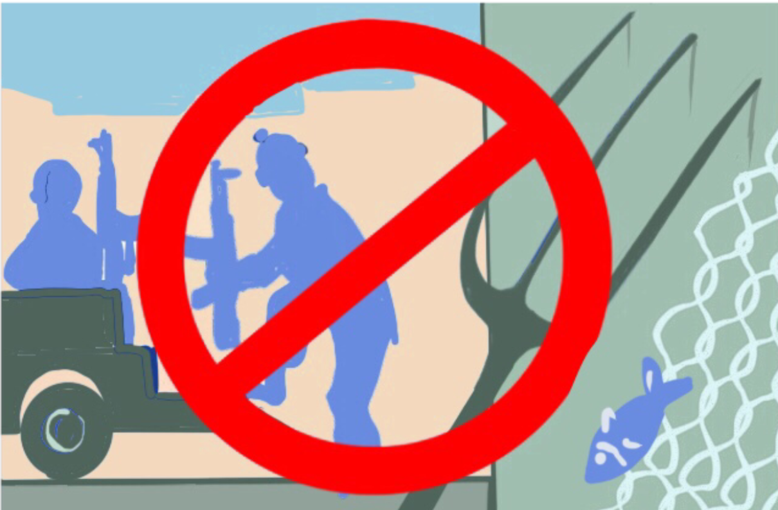
5) Conscription
  Armed actors should avoid conscripting farmers, fishers, and others engaged in vital food production and distribution.
12
Notes:
​Notes:
Explain that armed actors should consider providing exceptions for those who work as farmers, fishers, pastoralists, or are otherwise involved in food production, processing, or distribution. ​
Ask participants what is the practice in their context and how they think this could be implemented. ​
Ask them what could be the consequences if you conscript food producers (who would then produce the food?)​
What would be the challenges and opportunities with this measure?

Slide 13
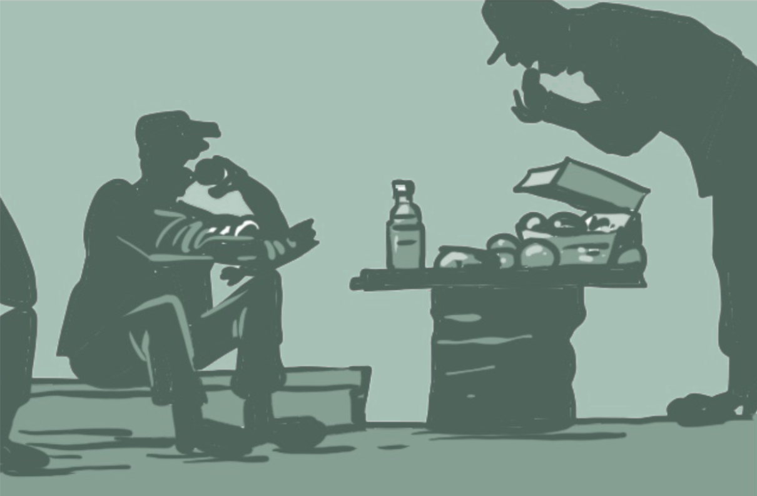
6) Looting
  Armed actors should strictly enforce the prohibition against looting civilian property
13
Notes:
Notes:
Explain that armed actors should strictly enforce the prohibition against the looting of civilian public and private property. ​
Ask participants how they think that this could be done and what would be needed to do so. Ask what armed actors should do if they cannot feed their troops?​
Listen to their inputs and explain that armed actors should provide all units with sufficient food and financial means, so that they do not supplement their supplies with civilian property. Where possible, have units cultivate their own food. Purchase food from communities only when it will not strain their own supply and where it will not pose a security risk for civilians (for example, by labeling them as having supported the “enemy”).​

Slide 14
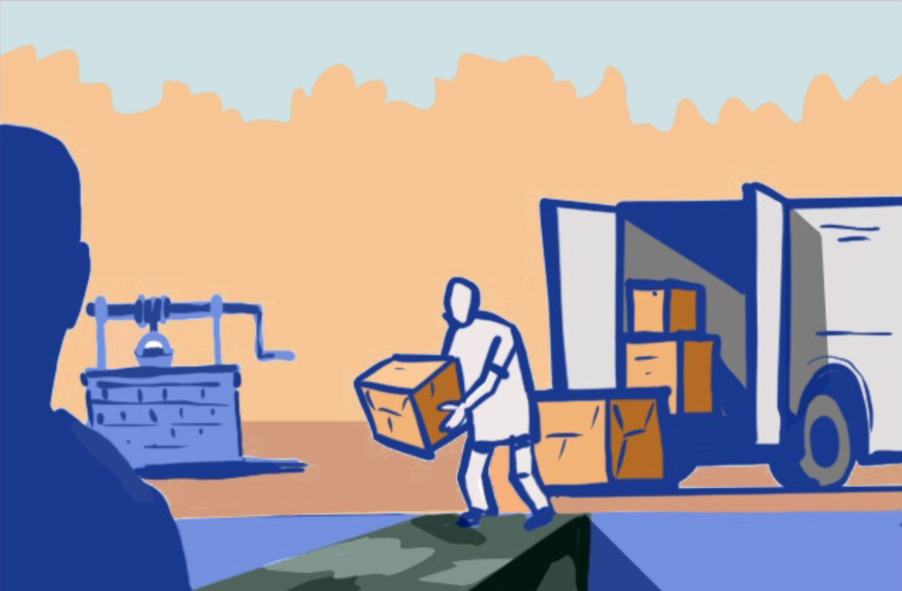
7) Access to food, water, critical infrastructure and essential services
Armed actors must facilitate the safe, rapid, and unimpeded access of affected people to food, water, critical infrastructure, and essential services.
​
This includes for example:​
  Not restrict civilians' freedom of movement​
  Avoid military presence in arable/pastoral land, markets, etc. ​
  Allow the timely movement of food into and out of ports​
  Avoid undue delays on any inspections of food or humanitarian assistance​
  Enter agreements on humanitarian corridors or pauses​
  Allow and facilitate for civilians to cultivate their own food.
14
Notes:
Notes:
Explain that armed actors must facilitate the safe, rapid, and unimpeded access of affected people to food, water, critical infrastructure, and essential services, including humanitarian assistance.​
Ask participants how they think this can be done and what would be needed to do so.​
Ask which actors are involved in providing or facilitating access to food and water in the target area? Do you have communication with them? How do or could armed actors help assure access to food and water? (directly and indirectly)​
Listen to their inputs and explain that armed actors should:​
not confine civilians or otherwise restrict their freedom of movement.
avoid military presence in arable/pastoral land and, fisheries, hunting areas, markets, etc., and avoid providing security for civilians to access these locations unless civilians specifically request this.​
allow the timely, unimpeded movement of food into and out of ports, through checkpoints and border crossings.​
Avoid undue delays on any inspections of food, water, or humanitarian assistance that would result in damages to materials, goods or transport, or be overly costly.
enter and uphold agreements on humanitarian corridors or pauses so that civilians can access food avoid excessive taxation on foodstuffs​
allow and facilitate for civilians to cultivate their own food. ​
​
​

Slide 15
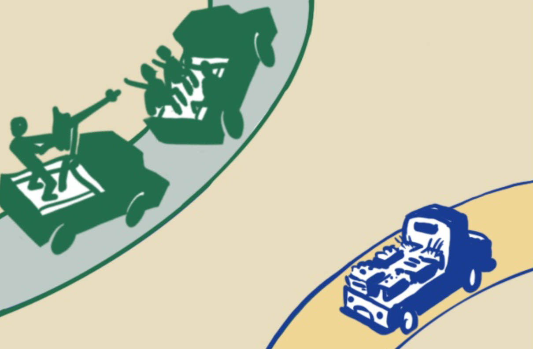
8) Humanitarian assistance and services
Armed actors must facilitate the safe, rapid, and unimpeded access of humanitarian assistance and services.
This includes for example:​
  Avoid restrictive bureaucratic and administrative measures​
  Avoid imposing restrictive measures on contacts by humanitarian actors with certain groups or individuals​
  Avoid requiring humanitarian actors to use armed escorts ​
  Avoid misinformation and disinformation about humanitarian actors
15
Notes:
​Notes:
Explain that armed actors must facilitate the safe, rapid, and unimpeded access of affected people to food, water, critical infrastructure, and essential services, including humanitarian assistance.​
Ask participants how they think this can be done and what would be needed to do so.​
Listen to their inputs and explain that armed actors should: ​
avoid imposing restrictive bureaucratic and administrative measures that delay humanitarian and civil society organizations' efforts to provide food assistance to civilians​.
avoid imposing restrictive measures that make any contact with certain groups or individuals by humanitarian actors illegal.​
avoid requiring humanitarian actors to use armed escorts and convoys as a condition to granting access to affected populations.​
avoid spreading misinformation and disinformation about humanitarian actors. This includes stating or implying that humanitarian actors are affiliated with an armed group or its political objectives, or claiming credit or responsibility for the assistance humanitarian actors deliver, as this can put humanitarian staff and programs at risk and jeopardize the entire response. ​
Remind then that humanitarian action is guided by the core humanitarian principles of humanity, neutrality, impartiality and operational independence. For details see: https://www.icvanetwork.org/uploads/2023/06/OOM_Humanitarian-Principles_Eng.pdf.
You can choose to show the video on "HUMANITARIAN ASSISTANCE AND ACCESS IN ARMED CONFLICT" produced by the Syria Regional Desk at the Diakonia International Humanitarian Law Center. The video features Arabic and English subtitles, as well as sign language interpretation. Available at: https://www.youtube.com/watch?v=ErSOD_htpM4&t=150s.
​
​

Slide 16
Case study
Questions:
​
  What can be considered bad versus good practices?​
  What are the consequences on civilians' food security?​
  What lessons can you take away from the case-study?
16
Notes:
​Notes:
Exercise 11: (about 30 minutes):​
Note: the case study is also available as Annex 2.D of the Facilitator’s Guide.
Divide participants into groups of 3-5. ​
Ask them to take at least 10 minutes to discuss the questions and agree on the answers.​
Ask each group to explain their answers and decisions and allow for debate.​
Case study​
Since the armed group (AG) has imposed a blockade and demanded payment of taxes at the various exits from the city, many farmers have simply decided to switch to other economic activities, such as petty trading or tailoring. For nearly four months, AG has tried to cut off the city, preventing supplies from getting in, creating severe shortages of foodstuffs and escalating price rises. With the harvest season about to end, much of the population has missed the opportunity to sell crops, leaving them vulnerable to extreme hunger and poverty in the coming months. ​
In response, the government forces have bombed villages suspected to shelter AG militants, damaging granaries and wells. Crops have been burned and livestock killed in retaliation. In support to the host state, foreign forces have conducted air strikes but regularly hit civilians and civilian objects instead. In one incident, nine farmers were killed, and an irrigation system destroyed. ​
Unexploded ordnances and landmines used indiscriminately impact arable land, including grazing and pastoral areas. Many people have fled the conflict areas, leaving their livelihoods behind. ​
Villagers have set up a militia force to defend themselves from attacks by both government forces and AG. Their combatants, many of them being farmers, are fed by their families. They regularly patrol lands and scan them for explosive remnants of war. In past months, a number of villagers have been executed in their fields by AG militants who accused them to provide food to government forces. ​
Almost no external aid reaches the villages. The government has blocked access to humanitarian agencies for fear of diversion after several attacks of convoys by AG militants, which further exacerbates food scarcity. The government suspects that agencies pay the group for access and has prohibited any contacts. At the present time, aid agencies are only authorized to operate in government-controlled areas with military escorts. ​
​
Questions:​
What can be considered bad versus good practices?​
What are the consequences on civilians' food security?​
What lessons can you take away from the case study?​
​

Slide 17

Module wrap-up & conclusions
17
Notes:
Notes:
Ask one or several of the participants to mention the most important things they learned/noted in the module. Take note on the flipchart or white board.​
​

Slide 18
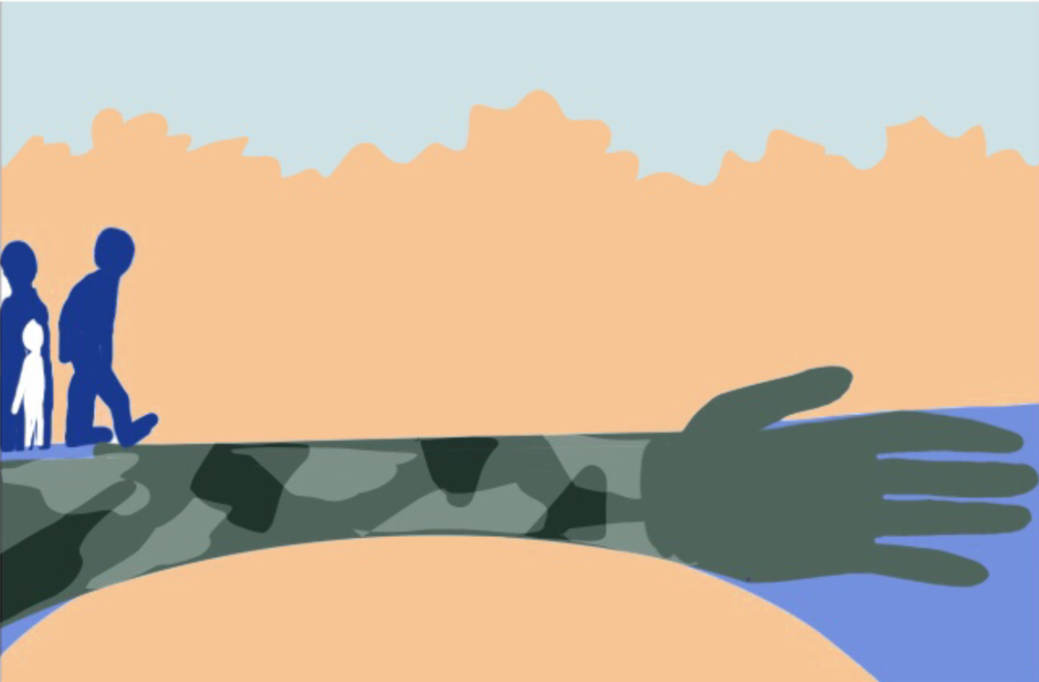
Questions ?
Notes:
Notes:
Address any questions or concerns raised by the participants.

