Slide 1
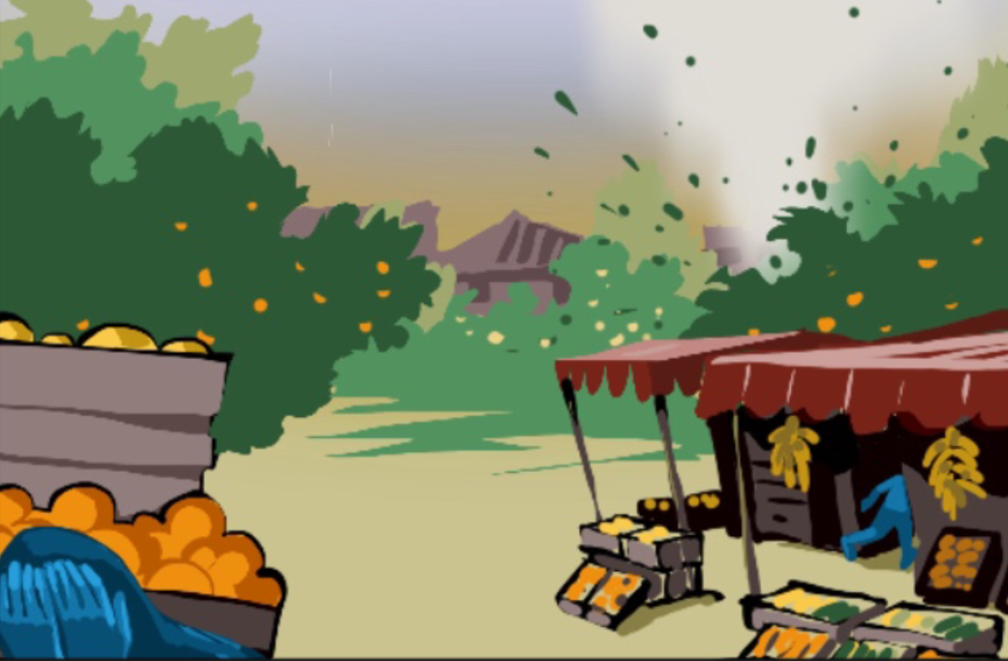
Training on the Practical Measures for Armed Actors to Prevent and Mitigate Conflict-Induced Food Insecurity
Module 6
Responses: Addressing Harm Caused​
Notes:
Notes:
Module 6: Responses: Addressing Harm Caused​
Note: modules 3-6 are primarily designed for armed actors..​
Time needed: 75 minutes​
- Session 11: Increasing food security: 30 minutes​
- Session 12: Ensuring accountability: 45 minutes​
Set-up: free set up, space for group work (in session 12)​
Material: flip chart or similar available for note-taking, big sheets of paper and markers for group exercises

Slide 2

Learning objective module 6
Participants are aware of the actions that they can take to increase food security, assess civilian harm, and ensure accountability according to the Practical Measures.
02
Notes:
Notes:
Learning objective: ​
Explain that the objective of this module is that participants are aware of the actions that they can take to increase food security, assess civilian harm, and to ensure accountability according to the Practical Measures. ​
​

Slide 3
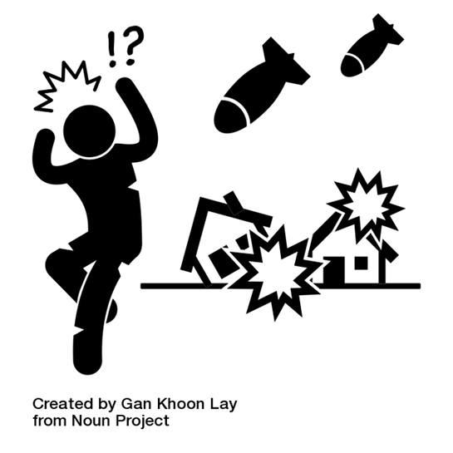
Addressing harm caused
  Armed actors should take all feasible steps to address the harm caused by their actions or omissions. ​
    How?​
  In consultation with affected people to identify the best ways to address people’s needs. ​
    When?​
  During and after conflict
03
Notes:
Notes:
Explain that in line with what has been discussed throughout the previous modules, armed actors should take all feasible steps to address the harm caused by their actions or omissions. ​
Ask them how they think that the actors can best do this?​
- In consultation with affected people to identify the best ways to address people’s needs. ​
- Others mentioned by participants​
Ask when should they do this?​
- Start while conflicts are ongoing and continue to do so after the hostilities end. ​
- Explain that food security may take a long time to improve, and efforts to reestablish it will necessarily extend beyond the conflict.​
​

Slide 4

Increasing food security
Armed actors must ensure civilian's access to food through:​
  Direct provision​
  Facilitation of humanitarian assistance
04
Notes:
Notes:
Explain that armed actors must provide or facilitate access to food, water, and essential services for the civilian population in areas under its control. ​
Ask the participants what they think could be done to help increase food security.​
Listen to their inputs and explains that armed actors should coordinate with affected communities and humanitarian aid organizations to do so, which may require them to:​
- Provide food directly and/or facilitate humanitarian assistance to affected communities and supporting communities to reach that assistance. Food should never be exchanged for sexual favors.​
- Facilitate humanitarian corridors, if needed.​
- Facilitate the transportation of food across borders.​
- Establish seed and food banks.​
- Undertake special agreements with adversaries for humanitarian relief.​
- Allow for displaced people to return to their lands.​
​
​
​
​
​
​

Slide 5

Ensuring accountability
  Towards the legal obligations​
  Towards the own policies​
  To the effects of actions/omission on the civilian population​
  Other?
05
Notes:
Notes:
Ask them how they understand the concept of accountability​.
Provide them with the definition that accountability is the quality or state of being accountable: an obligation or willingness to accept responsibility or to account for one's actions (https://www.merriam-webster.com/dictionary/accountability)​.
Ask them what they think are the main areas or spheres or accountability of armed actors, e.g. what they are accountable for and to?​
Listen to their answers and then show them the slide and explain that armed actors must hold themselves accountable ​towards:
- their legal obligations (as discussed in module 2, see also ICRC, International Humanitarian Law Database, Rule 139 and Rule 149.), ​
- their own policies and
- to the effects of their actions or omissions on the civilian population.​
- other things added by the participants?

Slide 6



  What tools for assessing civilian harm do you have in place?​
  When are assessments triggered?​
  How do they work?​
  Who conducts them?​
  If harm has been caused to civilians, especially to their food security, what do you do?
Assessing civilian harm
06
Notes:
Notes:
Exercise 13: (10 minutes in plenary)​
Ask them the following questions:
- what tools for post-operative assessments they have in place? ​
- when are they triggered? ​
- how do they work? ​
- who conducts these assessment?​
- if harm is found to have been caused to civilians and especially to their food security, what actions do they take? ​
​
​
​

Slide 7
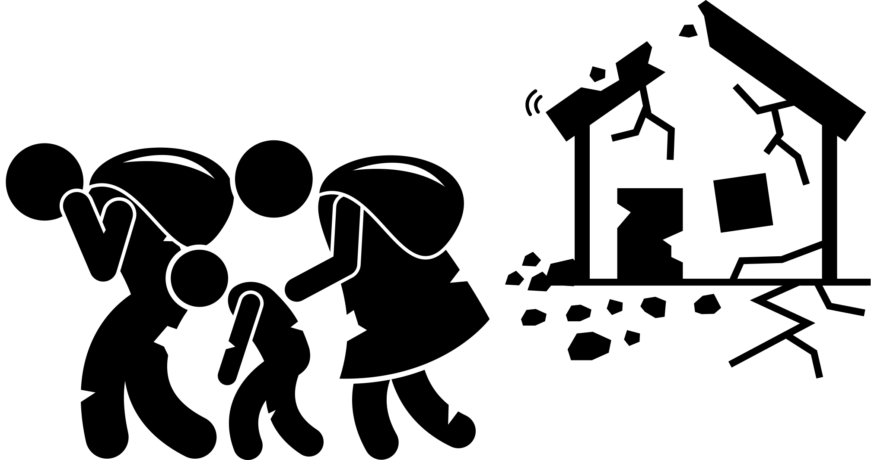
Assessing civilian harm: good practice
  Acknowledge the harm. ​
  Share information about that harm with relevant stakeholders.​
  Allow mine and unexploded ordnance marking, clearance, and risk education.
07
Notes:
Notes:
​
Explain that assessing civilian harm is often understood under the concept of “post-battle assessment”. It should be clear though that it does not only refer to harm caused by “battles” but can refer to any military operation or activity that causes civilian harm. ​
Explain that the Practical Measures includes some good practice on post-battle assessment.​
Where post-battle assessments show that an armed actor has caused civilian harm, especially to food security, they should:​
- Acknowledge the harm. Discuss with the affected civilians and/or community the most appropriate ways to compensate for it. This could include efforts to restore livelihoods (especially as they relate to food production), replace or reconstruct damaged civilian property and infrastructure indispensable to the food cycle, and/or provide cash compensation.​
- Share information about that harm with relevant stakeholders involved in humanitarian operations so they can mitigate and respond to the immediate impact on food security. This includes providing information relevant to clearing landmines and unexploded ordnance (UXO) from agricultural or pastoral lands, in fishing waters, or around food storage sites. ​
- Allow mine and UXO marking, clearance, and risk education in all affected areas. ​
You can share some good practice here, for example:​
The International Security Assistance Force (ISAF) creating a Civilian Casualty Tracking Cell in Afghanistan in 2008–2012, see https://ihl-in-action.icrc.org/case-study/afghanistan-implementation-civilian-casualty-tracking-cell
(Summary: The International Security Assistance Force (ISAF), led by the North Atlantic Treaty Organization (NATO), was active in Afghanistan between 2001 and 2014. It had a United Nations mandate to support the Afghan government in restoring security countrywide and to train Afghan forces. In 2008, allegations of civilian casualties caused by ISAF forces threatened to undermine its mission. In response, ISAF created a Civilian Casualty Tracking Cell (CCTC) to monitor such casualties. Informed by CCTC findings, ISAF and NATO issued new tactical directives and guidelines to mitigate civilian harm. The number of civilian casualties caused by pro-government forces apparently dropped from 828 in 2008 to 316 in 2012, reflecting the CCTC’s impact.)​
The African Union Mission in Somalia (AMISOM) taking steps to better protect civilians in Somalia (2012–2015), see https://ihl-in-action.icrc.org/case-study/somalia-amisom-takes-steps-enhance-protection-civilians​
(Summary: The African Union Mission in Somalia (AMISOM) was created by the African Union’s Peace and Security Council in 2007 as a peacekeeping mission with a mandate to support national reconciliation efforts in Somalia. Subsequently the mission faced allegations that it was responsible for civilian casualties. On 31 July 2015, an incident involving AMISOM troops led to the death of seven civilians. Prompted by the legal obligation to protect civilians and conscious that the success of its mission depended on earning the trust of the Somali population, AMISOM took concrete steps to protect civilians from the effects of hostilities.)​
​

Slide 8

Consequences
  In case of non-compliance with policies and procedures:​
    Investigations​
    Just processes and fair trials​
    Disciplinary action
08
Notes:
Notes:
Consequences of non-compliance with policies and procedures: ​
If members of an armed force do not follow policies and procedures put in place to comply with IHL and to prevent and mitigate conflict-induced food insecurity, the armed force must undertake penal procedures compliant with international norms. ​
This includes: ​
- investigations,
- ​just processes and fair trials, and
- ​application of appropriate disciplinary action as clearly reflected in the organization’s penal codes. ​
​

Slide 9

Exercise: Differential needs, risks, and impacts
  Which segments of the populations are most at risk when they are food insecure?
    Why are they at greater risk?
  What can be done to minimize food insecurity for these populations?
  How do we integrate differential impacts to population groups in our post-battle assessments?
  How do we integrate differential needs, risks and impacts in our efforts to increase food security?
09
Notes:
Notes:
Note: This exercise is designed to cover all the aspects covered in the module. If you which to make special emphasis on some aspects, you may decide to just focus on one or two of the questions.​
Exercise 14 on differential food needs: (could be done in smaller groups or in plenary) 10-15 minutes​
Depending on the size of the groups and the level of the participants, and the emphasis you may like to give it, this exercise might need longer time (about 15-20 minutes of group discussion and 10 minutes of feedback/discussion)​
Divide the participants into groups or 3-5 and have all of them answer the following questions: ​
Which segments of the populations are most at risk of food insecurity? When are they most at risk? Why are they at greater risk?​ If they have problems to understand, mention that the population is made up of individuals with a number of different characteristics and needs depending on their gender, age, social status, etc.​ Participants may think of populations with different needs, for example children, expecting mothers, breastfeeding women (and girls), populations in detention, displaced persons in informal camps or out of camps, poor children, elderly or persons with disabilities with limited mobility, etc.​
What can be done to minimize food insecurity for these populations? ​
How do we integrate differential impacts to population groups in our post-battle assessments?​ Who conducts them? (considerations of gender, ethnicity, etc.) ​
How do we integrate differential needs, risks and impacts in our efforts to increase food security?​
Background:​
When identifying specific needs and risks you might want to introduce the concept of vulnerability. Ask them how they understand the concept. (the concept should have come up also previously, for example in module 4)​
There may be different understandings and definitions but provide the participants the definition of the concept of vulnerability as a condition in which a person needs special protection and treatment. ​
(vulnerability= the quality or state of being exposed to the possibility of being attacked or harmed, either physically or emotionally.)​
This might be helpful for them to frame to understanding of the differential aspects in this exercise.​
Explain that some individuals may combine different vulnerabilities, which exposes them to more risks either of being food insecure or when they are food insecure (for example a poor women, from a minority ethnic group, who is displaced, and a widow). ​This relates to the concept of intersectionality (= the complex, cumulative way in which the effects of multiple forms of discrimination – such as racism, sexism, and classism – combine, overlap, or intersect especially in the experiences of marginalized individuals or groups https://www.merriam-webster.com/dictionary/intersectionality)​
​
​
​
​

Slide 10

Module wrap-up & conclusions
10
Notes:
Notes:
Ask one or several of the participants to mention the most important things they learned/noted in the module. Take note on the flipchart or white board.​
​

Slide 11
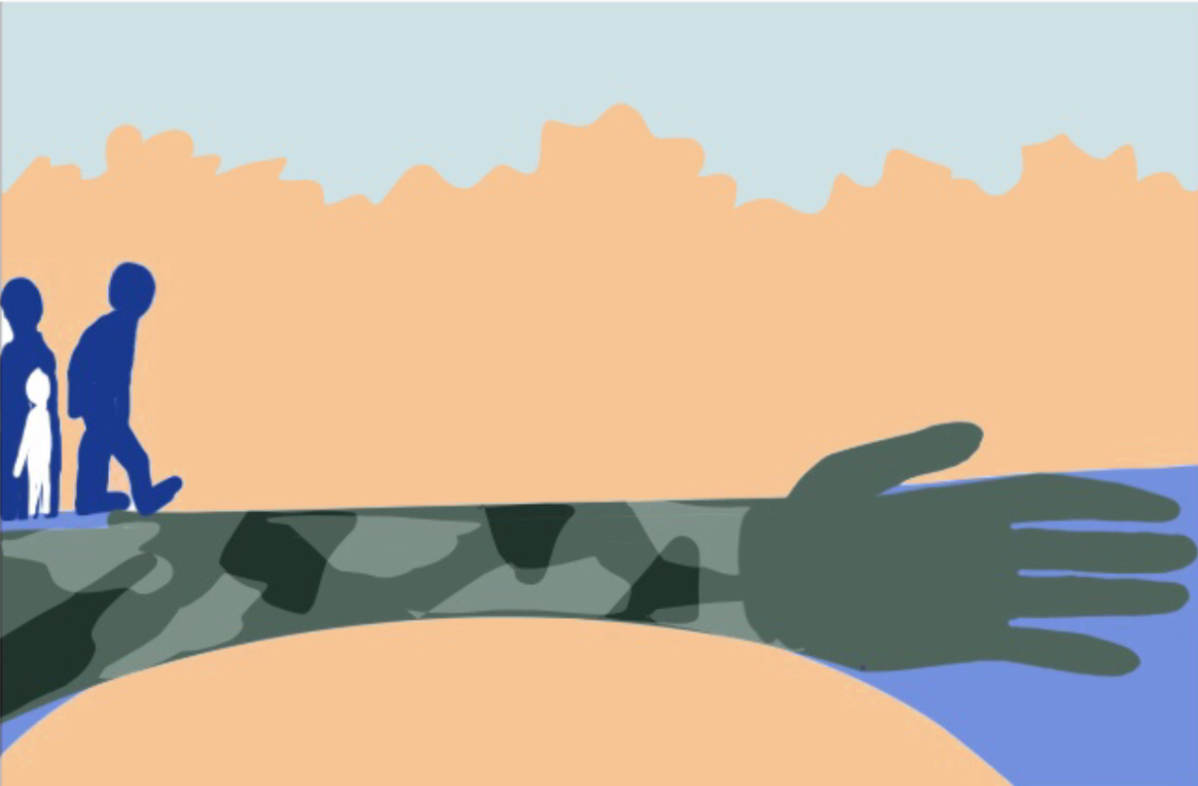
Questions?
Notes:
Notes:
Address any questions or concerns raised by the participants.

